Slide 1
Virtualization
CS 161: Lecture 23
4/24/19

Slide 2
The Challenge
How can we take an OS and user-mode processes, and trick them into thinking that they’re running on bare metal?
VM₀
VM₁
Guest processes
Guest processes
Guest OS
Guest OS
Virtual hardware interface
Hypervisor
Real hardware interface
Hardware
Also called a VMM
(“virtual machine monitor”)

Slide 3
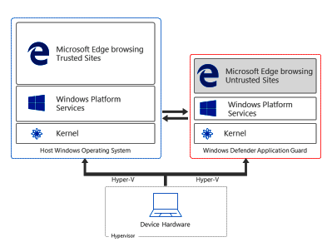
Why Is Virtualization Useful?
Security: Isolation between VMs is useful if VMs don’t trust each other, and/or host doesn’t trust VMs
Ex: In Windows 10 Enterprise, navigating to an untrusted website will open the web browser inside of a Hyper-V VM
“When an employee browses to a site that is not recognized or trusted by the network administrator, Application Guard steps in to isolate the potential threat . . . Application Guard creates a new instance of Windows at the hardware layer, with an entirely separate copy of the kernel and the minimum Windows Platform Services required to run Microsoft Edge. The underlying hardware enforces that this separate copy of Windows has no access to the user’s normal operating environment.”
Notes:
[Some of the Application Guard documentation refers to Hyper-V “containers,” but, as described in Reference [3], those “containers” are not Docker-style containers---they’re actually VMs.]
[Ref: [1] https://docs.microsoft.com/en-us/windows/security/threat-protection/windows-defender-application-guard/wd-app-guard-overview
[2] http://www.miru.ch/demystifying-windows-defender-application-guard/
[3] https://docs.microsoft.com/en-us/virtualization/windowscontainers/manage-containers/hyperv-container
[4] https://www.itprotoday.com/windows-8/differences-between-windows-containers-and-hyper-v-containers-windows-server-2016
]

Slide 4
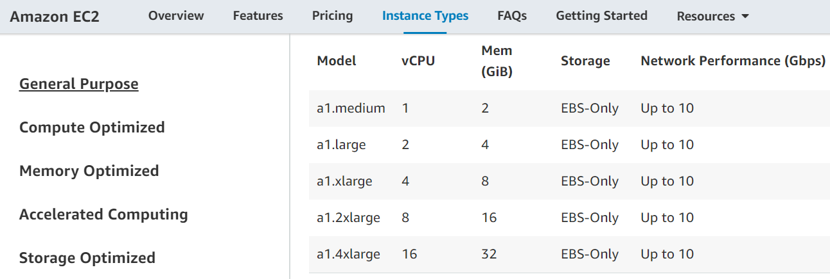
Why Is Virtualization Useful?
Server consolidation: VMs make it easy for the owner of a physical machine to rent that machine to others
Cram a bunch of somewhat-busy server apps onto a single physical machine
Cheaper than allocating a separate physical server per app
Ex: A multi-tenant datacenter like Amazon’s EC2 runs code from multiple parties on a single physical server

Slide 5
How Can We Implement Virtualization?
Hosted Interpretation
Popek-Goldberg VMMs
Dynamic Binary Translation
Hardware-assisted Virtualization

Slide 6
Hosted Interpretation
Run the VMM as a regular user application atop a host OS
VMM maintains a software-level representation of physical hardware
VMM steps through the instructions in the code of the VM, updating the virtual hardware as necessary
while(1){
curr_instr = fetch(virtHw.PC);
virtHw.PC += 4;
switch(curr_instr){
case ADD:
int sum = virtHw.regs[curr_instr.reg0] +
virtHw.regs[curr_instr.reg1];
virtHw.regs[curr_instr.reg0] = sum;
break;
case SUB:
//...etc...
Hosted interpretation used by Bochs (x86) and Gemulator (Atari)
Notes:
[Ref: http://bochs.sourceforge.net/Virtualization_Without_Hardware_Final.pdf]

Slide 7
Hosted Interpretation
Good: Easy to interpose on sensitive operations
The guest OS will want to read and write sensitive registers (e.g., %gs, %cr3), send commands to IO devices (e.g., inb), etc.
The interpreter can handle sensitive operations according to a policy
Ex: All VM disk IO is redirected to backing files in the host OS
Ex: VM cannot access the network at all, or can only access a predefined set of remote IP addresses
Good: Provides “complete” isolation (no guest instruction is directly executed on host hardware)
Good: Virtual ISA can be different than the physical ISA
Bad: Accurately emulating a modern processor is difficult
Bad: Interpretation is slow! [Ex: Bochs is 2x—3x slower than direct execution]

Slide 8
What If We Assume That The Virtual ISA Is The Same As The Physical ISA?

Slide 9
How Can We Implement Virtualization?
Hosted Interpretation
Popek-Goldberg VMMs
Dynamic Binary Translation
Hardware-assisted virtualization

Slide 10
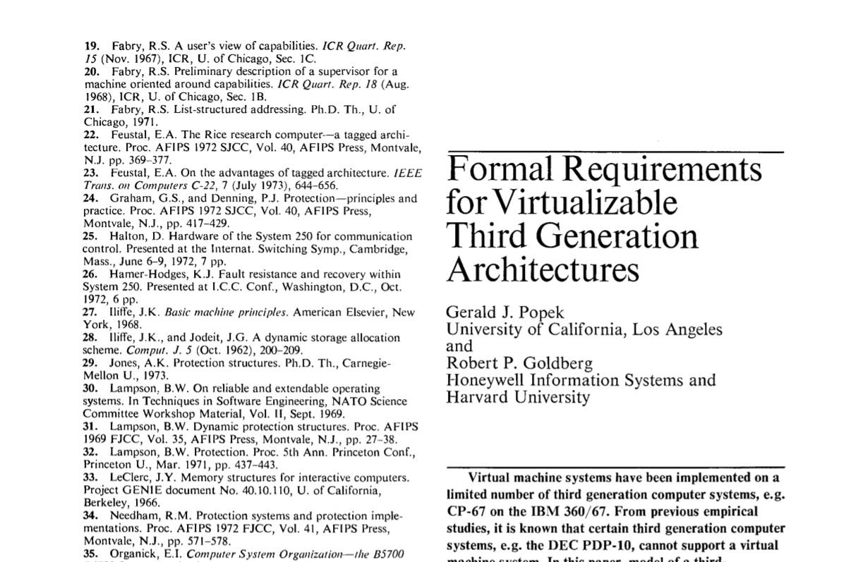
Popek and Goldberg: Terminology
Privileged instructions cause a trap if the processor isn’t in privileged mode
Sensitive instructions access low-level machine state (e.g., page tables, IO devices, privilege bits) that should be managed by control software (i.e., an OS or a VMM)
Safe instructions are not sensitive
A VMM is a control program that is:
Efficient: All safe guest instructions run directly on hardware
Omnipotent: Only the VMM can manipulate sensitive state
Undetectable: A guest cannot determine that it is running atop a VMM
hlt: halt the CPU until the next interrupt
invlpg: invalidate a tlb entry
mov %crXXX: write to a control register
inb: read a byte of data from an input port
Notes:
[The precise definition of a “third-generation computer” isn’t important with respect to the pedagogical goals of the lecture. Basically, a third-generation computer (1) has distinct “user” and “supervisor” modes, with user mode only having access to a subset of the instructions and trapping upon executing a supervisor-privileged instruction; (2) the machine uses a base+virt_addr model to generate physical addresses; (3) there are no interrupts or IO instructions. Only the first requirement is actually a strong one. The latter two make the paper’s formal argument easier to prove. See here for more details: https://pdfs.semanticscholar.org/d800/009a27fbc8da40095f9ab59ef72441c654bb.pdf]

Slide 11
Does x86 support Popek-Goldberg virtualization?

Slide 12
Observation 1: Only Ring 0 can invoke privileged instructions. Rings 1, 2, and 3 trap when invoking privileged instructions.
Observation 2: An x86 PTE only has a single bit to indicate user/supervisor! The MMU maps Rings 0, 1, and 2 to “supervisor,” and Ring 3 to “user.”
Least
privileged
Ring 3
Ring 2
The Normal x86 Setup
Ring 1
User-mode accessible?
User apps
Intel originally thought that device drivers could be “isolated” here
However, “isolated” drivers in Rings 1 or 2 can still access ring 0 memory pages, so isolation is weak in practice without additional segment-based protection (but segment support was dropped in x86-64)
Also, most non-x86 chips only define two privilege levels, so portable OSes shouldn’t leverage Rings 1 and 2
Ring 3
Writeable?
Ring 0
Nothing
Ring 2
Present?
Nothing
Ring 1
PTE
4KB-aligned physFrame addr
OS
Ring 0
63
48
47
12
11
3
2
1
0
Most
x86 Rings
x86
privileged
Notes:
On x86, an example of a privileged instruction is the instruction which invalidates a TLB entry. Only code that runs in Ring 0 should be able to invalidate a TLB entry.
[As described by ”Bringing Virtualization to the x86 Architecture with the Original VMware Workstation” [http://www.cs.columbia.edu/~cdall/candidacy/pdf/Bugnion2012.pdf] (Section 6.2.1) an x86-32 can place the VMM in ring 0, the guest OS in ring 1, and the guest apps in ring 1, such that:
*the VMM and the guest OS are protected from each other using segments (so that, even though the x86 MMU treats privilege levels 0--2 as supervisor w.r.t. to the u/s bit in page tables, the guest OS cannot access VMM memory);
*the guest OS and the guest apps are protected from each other (because page protections will prevent the ring 3 guest apps from accessing ring 1 guest OS pages).
However, x86-64 does not support segmentation! So, the guest OS has to be placed in Ring 3, to prevent the guest OS from being able to access hypervisor memory.]
[Ref: https://www.virtualbox.org/manual/ch10.html#hwvirt //Section 10.5 describes how, when VirtualBox uses software virtualization,
//it puts the guest OS in Ring 1. This is nice because the guest OS will trap
//when executing privileged instructions, but not all sensitive instructions
//are privileged, so VirtualBox must perform dynamic binary translation.
“Intel Virtualization Technology” by Uhlig et al. http://citeseerx.ist.psu.edu/viewdoc/download?doi=10.1.1.459.3814&rep=rep1&type=pdf
//A great discussion of the challenges of virtualizing x86
]

Slide 13
Guest apps
Ring 3
Guest OS
VMM
Ring 0
x86
Guest app executes syscall to read from keyboard
Hardware generates trap which is handled by VMM
VMM vectors control to guest OS’s interrupt handler
Guest OS tries to execute inb to read a key from the keyboard
Hardware traps to VMM
VMM executes real inb
Theorem: A virtual machine monitor can be constructed for architectures in which every sensitive instruction is privileged.

Slide 14
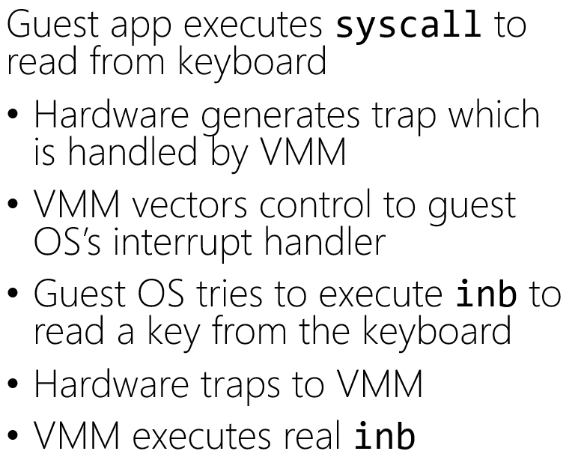
If the guest OS is mapped into the same address space as the guest apps, then the guest apps can read and write the guest OS’s state!
Guest apps
Ring 3
Guest OS
VMM
Ring 0
x86
VMM places result where the guest OS expects it to be
VMM vectors control back to the guest OS
OS does some processing and then does an iret or sysexit
Hardware traps to VMM
VMM returns to user-mode
I still want isolation between the guest OS and the guest apps!

Slide 15
There’s another problem . . .

Slide 16
Theorem: A virtual machine monitor can be constructed for architectures in which every sensitive instruction is privileged.
For many years, x86 had sensitive instructions that weren’t privileged!
Notes:
[References: “Analysis of the Intel Pentium’s Ability To Support A Secure Virtual Machine Monitor” http://www.cse.psu.edu/~buu1/teaching/spring06/papers/analysis-pentium.pdf]

Slide 17
The x86 push instruction was not PG-virtualizable!
push can push a register value onto the top of the stack
%cs register contains (among other things) 2 bits that represent the current privilege level
A guest OS running in Ring 3 could push %cs and see that the privilege level isn’t Ring 0!
To be virtualizable, push should cause a trap when invoked from Ring 3, allowing the VMM to push a fake %cs value which indicates that the guest OS is running in Ring 0

Slide 18
The x86 pushf/popf instructions weren’t PG-virtualizable!
pushf/popf read/write the %eflags register using the value on the top of the stack
Bit 9 of %eflags enables interrupts
In Ring 0, popf can set bit 9, but in Ring 3, CPU silently ignores popf!
To be virtualizable, pushf/popf should cause traps in Ring 3
Allows VMM to detect when guest OS wants to changes its interrupt level (meaning that the VMM should change which interrupts it forwards to the guest OS)
x86 had 17 non-PG-virtualizable instructions!

Slide 19
How Can We Implement Virtualization?
Hosted Interpretation
Popek-Goldberg VMMs
Dynamic Binary Translation
Hardware-assisted virtualization

Slide 20
Dynamic Translation
mov 32(%rbp), %rbx
sub %rbx, %rcx
push %rcx
popf //Sensitive instruction,
//but not privileged!
//Won’t trap when called
//in Ring 3.
Suppose that:
VMM runs in Ring 0
Guest OS and guest apps run in Ring 3
Allow guest user-level programs to run directly atop hardware . . .
. . . but the VMM rewrites the guest OS’s binary on-the-fly!
Translate sensitive-but-unprivileged instructions into ones that trap to the VMM
Translation starts when the VMM initially loads the guest OS binary
Translator handles a few instructions at a time (no bigger than a basic block)
VMM caches frequently-used translations to amortize translation costs
Original guest OS code
mov 32(%rbp), %rbx
sub %rbx, %rcx
push %rcx
int3
//A special one-byte
//instruction that traps.
//Originally intended for
//use by debuggers to set
//breakpoints.
Translated guest OS code
Notes:
[Refs: https://en.wikipedia.org/wiki/INT_(x86_instruction)#INT3
“Bringing Virtualization to the x86 Architecture with the Original VMware Workstation” http://www.cs.columbia.edu/~cdall/candidacy/pdf/Bugnion2012.pdf
“A Comparison of Software and Hardware Techniques for x86 Virtualization” https://www.vmware.com/pdf/asplos235_adams.pdf
]

Slide 21
Emo kid’s problem is still unsolved!
Guest apps
I want isolation between the guest OS and the guest apps!
Ring 3
Guest OS
VMM
Ring 0
x86
Notes:
[As described in Section 6.2.1 of Bugnion2012, this problem can be solved on systems like x86-64 that lack paging support. Quoth the paper: “We did evaluate alternatives that relied on paging rather than segmentation . . . Unfortunately, the design alternatives all had two major downsides: first, the x86 architecture defined only one single protection bit at the page level (pte.us). Since we require three levels of protection (VMM, guest kernel, guest applications), the VMM would need to maintain two distinct page tables: one for guest applications and VMM, the other for guest kernel (running at %cpl=3!) and VMM. Second, and probably most critically, binary translators always need a low-overhead and secure mechanism to access their own supporting data structures from within translated code. Without hardware segment limit checking, we would lose the opportunity to use hardware-based segmentation and instead would have had to build a software fault isolation framework.” Remember that the VMM needs to isolate the VMM from the guest OS and the guest apps, and the guest OS from the guest apps. On x86-32, this was done by placing the VMM at Ring 0, the guest OS at Ring 1, and the guest apps at Ring 3. The paging hardware only differentiates between “user” (Ring 3) and “supervisor” (Rings 0, 1, and 2), so paging can only protect the VMM and the guest OS from guest apps. However, segments can prevent Ring 1 guest OS code from accessing Ring 0 VMM code.]

Slide 22
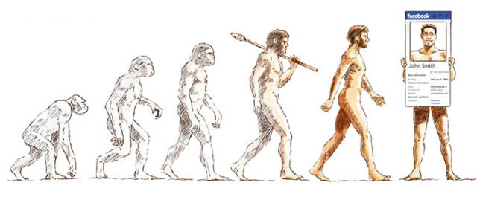
How Can We Implement Virtualization?
Hosted Interpretation
Popek-Goldberg VMMs
Dynamic Binary Translation
Hardware-assisted virtualization

Slide 23
Intel VT-x
VT-x doesn’t change the complex semantics of preexisting x86 instructions
Instead, VT-x:
Creates two copies of the processor’s architecturally-visible state, e.g.,
General-purpose registers like %rax
The special register %cs (which indicates the current privilege level!)
The page-table pointer %cr3
Creates two new privilege modes (root and non-root) that are orthogonal to ring privileges
VMMs run in root mode
VMs run in non-root mode
Transitions between the two modes are atomic
Switching between root and non-root requires a single instruction or trap; architectural state automatically saved and restored by hardware
In contrast, a normal context switch involves a complicated dance of state saving and restoring!
Boo!
The Ghost of
Backwards Compatibility
The two modes use different address spaces (because they use different %cr3’s)!

Slide 24
VM 1
VM 2
VMM stores a VM control structure (VMCS) in physical memory for each VM
Holds the architectural state of a swapped-out VM
Hypervisor calls vmresume to load VMCS state onto a CPU and start the VM
A VM runs until:
VM executes a privileged or “classic” x86 sensitive-but-unprivileged” instruction
External interrupt arrives (e.g., from IO device or timer)
Guest OS explicitly invokes the vmcall instruction
VM generates a page fault
User apps
Ring 3
User apps
Ring 3
Nothing
Ring 2
Nothing
Ring 2
Non-root
Non-root
Nothing
Ring 1
Nothing
Ring 1
OS
Ring 0
OS
Ring 0
User apps
Ring 3
Nothing
Ring 2
Root
Nothing
Ring 1
VMM
Ring 0
VMCS:VM 1
VMCS:VM 2
Notes:
[Note that a VM-level page fault only traps to the VMM if the page fault is induced by the EPT part of the page walk! In other words, if an address translation hits an unmapped region in the guest %cr3’s page table, the page fault is handled by the guest OS. However, if an address translation hits an unmapped region in the EPT’s page table, then the fault is sent to the VMM.]
[Even if non-root mode has disabled interrupts, the arrival of an interrupt will cause a trap to the VMM if non-root code is running. See page 56 of the reference below.]

Slide 25
Virtualizing the MMU
Goals
Allow a guest OS to believe that it controls the virtual-to-physical mapping
Enable a VMM to actually control which guest pages live in RAM and where those pages live
Definitions
Guest virtual memory: Visible to guest applications
Guest physical memory: What the guest OS maps guest virtual memory to
Host physical memory: What the VMM maps guest physical memory to

Slide 26
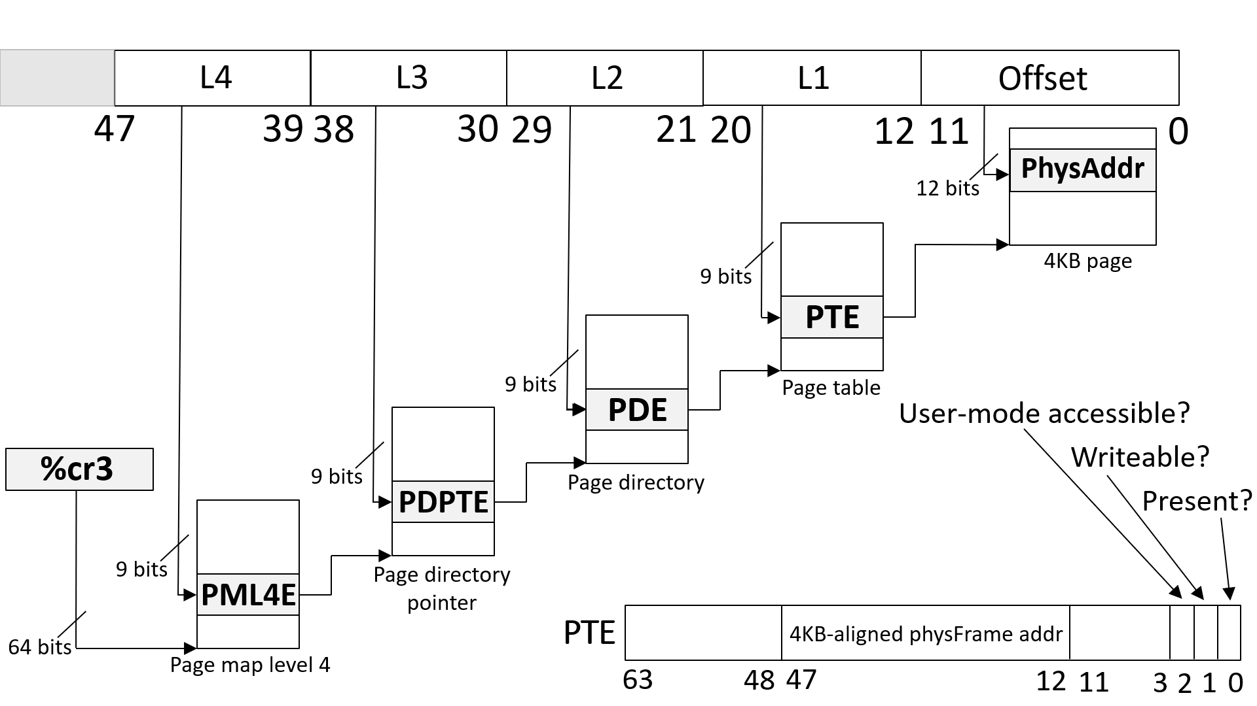
Intel VT-x EPT
Guest-level %cr3 and page tables contain guest physical addresses
VMM needs to translate each of those addresses to host physical addresses
Root mode and non-root mode have their own %cr3
However, the VMM manages a hidden EPT (“extended page table”) register which is consulted when a TLB miss occurs in non-root mode
An extended page table maps guest physical addresses to host physical addresses
During a TLB miss in non-root mode, the hardware:
Uses the EPT to translate each guest physical address in layers 4, 3, 2, and 1 of the non-root page table
Installs the appropriate guest-virtual to host-physical mapping in the TLB
Using the EPT, the hypervisor controls how host physical RAM is actually used
EPT translation is:
Enabled during VM entry: hardware loads EPT register using a saved value in the VMCS
Disabled during VM exit: hardware saves the current EPT register in the VMCS
TLB is flushed during a root<-->non-root transition
Note that a TLB miss is not a transition!

Slide 27
Handling a TLB miss on an EPT processor

Slide 28
Guest %cr3
VMM-managed %ept
(i.e., pointer to PML4)
(i.e., pointer to PML4)
gPA
hPA
⊕
Index
Memory read
hPA
PML4E
Next slide . . .
⊕
Index
Memory read
hPA
PDPTE
⊕
Index
Memory read
hPA
PDE
The host physical address where the hypervisor put the guest’s PML4 table
⊕
Index
Memory read
hPA
PTE

Slide 29
Guest physical address
VMM-managed %ept
of L3 table
(i.e., pointer to PML4)
gPA
hPA
⊕
Index
Memory read
hPA
PML4E
Output of prior slide
⊕
Guest virtual
Host physical
Index
Memory read
address to
address of guest’s
hPA
PDPTE
translate
PML4 table
gVA
hPA
⊕
Index
Memory read
⊕
hPA
PDE
Index
Memory read
gPA
PML4E
⊕
Index
(Contains guest physical
Memory read
address of L3 table)
hPA
PTE

Slide 30
Guest physical address
VMM-managed %ept
of L2 table
(i.e., pointer to PML4)
gPA
hPA
⊕
Index
Memory read
hPA
PML4E
Output of prior slide
⊕
Guest virtual
Host physical
Index
Memory read
address to
address of guest’s
hPA
PDPTE
translate
L3 table
gVA
hPA
⊕
Index
Memory read
⊕
hPA
PDE
Index
Memory read
gPA
PDPTE
⊕
Index
(Contains guest physical
Memory read
address of L2 table)
hPA
PTE

Slide 31
Guest physical address
VMM-managed %ept
of L1 table
(i.e., pointer to PML4)
gPA
hPA
⊕
Index
Memory read
hPA
PML4E
Output of prior slide
⊕
Guest virtual
Host physical
Index
Memory read
address to
address of guest’s
hPA
PDPTE
translate
L2 table
gVA
hPA
⊕
Index
Memory read
⊕
hPA
PDE
Index
Memory read
gPA
PDE
⊕
Index
(Contains guest physical
Memory read
address of L1 table)
hPA
PTE

Slide 32
Guest physical address
VMM-managed %ept
of target physical page
(i.e., pointer to PML4)
gPA
hPA
⊕
Index
Memory read
hPA
PML4E
Output of prior slide
⊕
Guest virtual
Host physical
Index
Memory read
address to
address of guest’s
hPA
PDPTE
translate
L1 table
gVA
hPA
⊕
Index
Memory read
⊕
hPA
PDE
Index
Memory read
gPA
PTE
⊕
Index
(Contains guest physical
Memory read
address of target physical page)
hPA
PTE

Slide 33
WE DID IT
WE GOT THAT TRANSLATION DONE
FEELS GOOD

Slide 34
Guest physical address
VMM-managed %ept
target physical page
(i.e., pointer to PML4)
gPA
hPA
In non-root mode, a TLB entry maps a guest virtual page to a host physical page
The PTE at the bottom-right of the slide contains the host physical page number for the guest virtual address which caused the TLB miss
EPT makes address translation much slower!
Regular x86-64 page walk: 4 memory accesses
EPT page walk: 24 memory accesses
Luckily, VT-x processors maintain caches for various intermediate mappings
⊕
Index
Memory read
hPA
PML4E
Output of prior slide
⊕
Guest virtual
Host physical
Index
Memory read
address to
address of guest’s
hPA
PDPTE
translate
L1 table
gVA
hPA
⊕
Index
Memory read
⊕
hPA
PDE
Index
Memory read
gPA
PTE
⊕
Index
(Contains guest physical
Memory read
address of target physical page)
hPA
PTE

