Slide 1
Processor Design
CS 161: Lecture 1
1/28/19

Slide 2
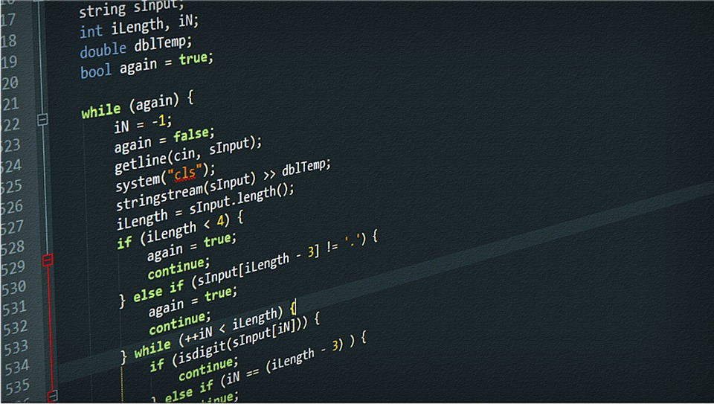
Processors: From the View of a Terrible Programmer
Letter “m”
Drawing
of bird
ANSWERS
Source code
Compilation
addq %r11, %r12
movq 8(%rbx), %r9
cmpq %rax, %rbx
Machine instructions
A HARDWARE MAGIC OCCURS

Slide 3
Processors: From the View of a Mediocre Programmer
Program instructions live in RAM
IP (“instruction pointer”) register points to memory address of next instruction to fetch and execute
Arithmetic logic unit (ALU)
Inputs are register values
Performs operation on inputs (e.g., add, divide)
Writes result to output register or memory address
Some instructions cause devices to perform actions
Registers versus RAM
Registers are orders of magnitude faster for ALU to access (0.3ns versus 120ns)
RAM is orders of magnitude larger (a few dozen registers versus GBs of RAM)
Register size defines the “-bit” part of a CPU
Ex: 64-bit architectures have 64-bit-large registers
Registers
IP
RAM
Instruction to execute
ALU
Devices

Slide 4
Instruction Set Architectures (ISAs)
ISA defines the instructions and registers which hardware presents to software
A compiler translates high-level source code (e.g., C++, Go) to the instructions for a target processor’s ISA
The processor directly executes ISA instructions
Example ISAs
ARMv8.2-A: 64-bit ISA popular on smartphones and embedded devices
x86-64: 64-bit ISA popular on desktop, laptops, and servers; known to cause sadness among programmers and hardware developers

Slide 5
ISAs: The Three Basic Instruction Types
Arithmetic/bitwise logic
Ex: Multiply two register values and store result in a third register
Ex: Left-shift a register value by 2 bits
Data movement between registers and/or memory
Ex: Store a register’s value into memory
Ex: Load a memory value into a register
Control flow
Ex: Unconditionally jump to a particular instruction
Ex: Jump to an instruction if a register has a value of 0
Ex: Call a function

Slide 6
RISC vs CISC: ISA Wars
CISC (Complex Instruction Set Computer)
A single instruction often does many things
Instructions are often variable-size to minimize RAM usage
CISC instructions make life easier for compiler writers, but much more difficult for hardware designers—complex instructions are hard to implement and make fast
x86 is the classic CISC ISA

Slide 7
RISC vs CISC: ISA Wars
CISC (Complex Instruction Set Computer)
A single instruction often does many things
Instructions are often variable-size to minimize RAM usage
CISC instructions make life easier for compiler writers, but much more difficult for hardware designers—complex instructions are hard to implement and make fast
x86 is the classic CISC ISA
//Copy %rax register’s val to %rbx
mov %rax, %rbx
//Copy *(%rsp+16) to %rbx
mov 16(%rsp), %rbx
//Copy %rbx register val to *(%rsp+8)
mov %rbx, 8(%rsp)
mov instruction: Operands can both be registers, or one register/one memory location

Slide 8
RISC vs CISC: ISA Wars
A single hardware instruction has to do:
a condition test
a memory read
a memory write
two register increments or decrements
That’s a lot!
CISC (Complex Instruction Set Computer)
A single instruction often does many things
Instructions are often variable-size to minimize RAM usage
CISC instructions make life easier for compiler writers, but much more difficult for hardware designers—complex instructions are hard to implement and make fast
x86 is the classic CISC ISA
if(cpu_direction_flag == 0){
*(%rdi++) = *(%rsi++);
}else{
*(%rdi--) = *(%rsi--);
}
//Copy %rax register’s val to %rbx
mov %rax, %rbx
//Copy *(%rsp+16) to %rbx
mov 16(%rsp), %rbx
//Copy %rbx register val to *(%rsp+8)
mov %rbx, 8(%rsp)
mov instruction: Operands can both be registers, or one register/one memory location
//movsb: Copy 1 byte from one
// pointer to another
//%rdi: Destination pointer
//%rsi: Source pointer
if(cpu_direction_flag == 0){
*(%rdi++) = *(rsi++);
}else{
*(%rdi--) = *(%rsi--);
}
if(cpu_direction_flag == 0){
*(%rdi++) = *(%rsi++);
}else{
*(%rdi--) = *(%rsi--);
}
Notes:
[Note that in movsb, the source and destination pointers are hardcoded into the instruction itself.]

Slide 9
RISC vs CISC: ISA Wars
RISC (Reduced Instruction Set Computer)
Each instruction does a simple thing
Instructions are fixed-sized (or at least easy decode)
Load/store architecture: all instructions but loads and stores manipulate registers
RISC ISAs make it easier to design fast, power-efficient hardware
Ex: MIPS, ARM
//On MIPS, operands for mov instr
//can only be registers!
mov a0, a1 //Copy a0 register value
//to a1
//In fact, mov is a pseudoinstruction
//that isn’t in the ISA! Compiler
//translates the above to:
addi 0, a0, a1 //a1 = a0 + 0
RAM is cheap, power efficiency is important, and RISC makes it easier to design fast CPUs—so who cares if compilers must work a little harder to compile code?

Slide 10
x86-64: Registers
16 general-purpose integer registers
%rbp: break pointer
%rsp: stack pointer
%rax, %rbx, %rcx, %rdx, %rsi, %rdi, %r8, %r9, %r10, %r11, %r12, %r13, %r14, %r15: used for various purposes
%rip: instruction pointer (i.e., holds the address of the next instruction to execute)
Incremented or decremented by more than one instruction during jumps, function calls/returns
Various special-purpose registers like:
%cr3: the page table pointer
%xmm0—%xmm15: floating point registers

Slide 11
x86-64: System V Calling Convention
Simplest case: callee arguments+retval are integers or pointers
Caller stores first six arguments in %rdi, %rsi, %rdx, %rcx, %r8, and %r9
Remaining arguments are passed via the stack
Callee places return value in %rax
int64_t foo(int64_t a, int64_t b,
int64_t c, int64_t d,
int64_t e, int64_t f,
int64_t g, int64_t h){
int64_t local0 = a*b*c;
int64_t local1 = d*e*f;
return local0 - local1;
}
Caller info
h
g
return addr
saved %rbp
%rbp
local0
local1
%rsp
a
b
c
d
e
f
%rdi
%rsi
%rdx
%rcx
%r8
%r9
Notes:
System V was one of the first commercial versions of the Unix operating system. The design of Unix was extremely influential on subsequent operating systems like Linux. [Reference: https://en.wikipedia.org/wiki/UNIX_System_V]
Note that, if a stack-passed integer argument is smaller than 64 bits, the argument is rounded up to 64-bits in size before being placed on the stack.

Slide 12
Caller-saved regs
%rdi%, %rsi, %rdx, %rcx, %r8, %r9, %r10, %r11, %rax
Can be overwritten by callee, so if the caller wants to preserve their value, must do so *before* invoking callee
Callee-saved regs
%rbp, %rbx, %r12, %r13, %r14, %r15
Assumed by caller to *not* be modified by callee, so callee must push old values on the stack *before* updating these registers
//Code at start of function.
//Save old breakpointer.
pushq %rbp
movq %rsp, %rbp
//Assume that function needs
//to overwrite callee-saved
//%rbx and %r12.
pushq %rbx
pushq %r12
//Allocate local vars.
subq $0x10, %rsp
//Rest of function . . .
int64_t foo(int64_t a, int64_t b,
int64_t c, int64_t d,
int64_t e, int64_t f,
int64_t g, int64_t h){
int64_t local0 = a*b*c;
int64_t local1 = d*e*f;
return local0 - local1;
}
Caller info
h
g
return addr
saved %rbp
%rbp
local0
local1
%rsp
a
b
c
d
e
f
%rdi
%rsi
%rdx
%rcx
%r8
%r9
Notes:
If we look at the bottom of the diagram, we see that the first six arguments for the callee are stored in %rdi, %rsi, %rdx, and so on. This is why these registers are *caller* saved---the caller has to stash the old values in these registers before using the registers to pass arguments to the callee.

Slide 13
How can a processor efficiently execute instructions?

Slide 14
Pipelining: The Need for Speed
Vin Diesel needs more cars because VIN DIESEL
A single car must be constructed in stages
Build the floorboard
Build the frame
Attach floorboard to frame
Install engine
I DON’T KNOW HOW CARS ARE MADE BUT YOU GET THE POINT
Q: How do you design the car factory?

Slide 15
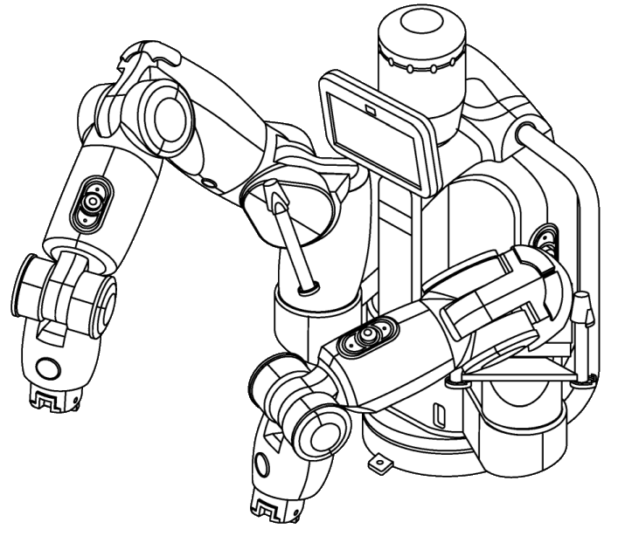
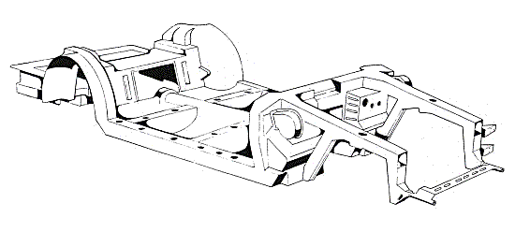
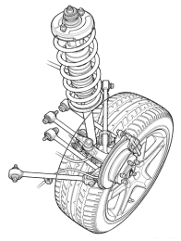
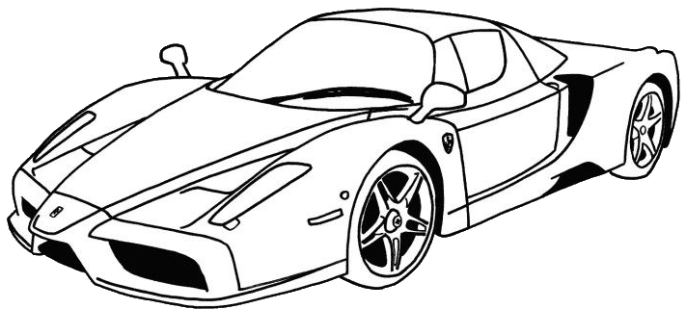
Factory Design #1
Suppose that building a car requires three tasks that must be performed in serial (i.e., the tasks cannot be overlapped)
Further suppose that each task takes the same amount of time
We can design a single, complex robot that can perform all of the tasks
The factory will build one car every three time units
t=0
t=1
t=2

Slide 16
Factory Design #2
Alternatively, we can build three simple robots, each of which performs one task
The robots can work in parallel, performing their tasks on different cars simultaneously
Once the factory ramps up, it can make one car every time unit!
t=0
Car 0
t=1
Car 1
Car 0
The factory has ramped up: the pipeline is now full!
t=2
Car 2
Car 1
Car 0
t=3
Car 3
Car 2
Car 1

Slide 17
Pipelining a Processor
Executing an instruction requires five steps to be performed
Fetch: Pull the instruction from RAM into the processor
Decode: Determine the type of the instruction and extract the operands (e.g., the register indices, the immediate value, etc.)
Execute: If necessary, perform the arithmetic operation that is associated with the instruction
Memory: If necessary, read or write a value from/to RAM
Writeback: If necessary, update a register with the result of an arithmetic operation or a RAM read
Place each step in its own hardware stage
This increases the number of instructions finished per time unit, as in the car example
A processor’s clock frequency is the rate at which its pipeline completes instructions

Slide 18
Processors: From the View of a Master Programmer
+
Next sequential IP
Conditions?
Sign-extended imm
Instr
Read reg0 idx
size
+
Read reg1 idx
Opcode
Write reg idx
Write reg data
Addr
IP
Current instruction register
ID/EX
EX/MEM
MEM/WB
Memory
Read data 0
Instr
Read data 1
ALU
Registers
?
RdData
Memory
Sign extend
imm to 64-bit
?
Addr
Write reg idx
WrData

Slide 19
Fetch:addq %r8, %r9
+
Conditions?
//IP=addr of addq instr
//Fetch addq instr, increment
//IP to next instr
Next sequential IP
Sign-extended imm
Instr
Read reg0 idx
size
+
Read reg1 idx
Opcode
Write reg idx
Write reg data
Addr
IP
Current instruction register
ID/EX
EX/MEM
MEM/WB
Memory
Read data 0
Instr
Read data 1
ALU
Registers
?
RdData
Memory
Sign extend
imm to 64-bit
?
Addr
Write reg idx
WrData

Slide 20
Decode:addq %r8, %r9
+
Conditions?
//Read reg0=%r8 Read reg1=%r9
//Write reg=%r9
//Opcode=add
Next sequential IP
Sign-extended imm
Instr
Read reg0 idx
size
+
Read reg1 idx
Opcode
Write reg idx
Write reg data
Addr
IP
Current instruction register
ID/EX
EX/MEM
MEM/WB
Memory
Read data 0
Instr
Read data 1
ALU
Registers
?
RdData
Memory
Sign extend
imm to 64-bit
?
Addr
Write reg idx
WrData

Slide 21
Execute:addq %r8, %r9
+
Conditions?
//Calculate read data 0 +
// read data 1
Next sequential IP
Sign-extended imm
Instr
Read reg0 idx
size
+
Read reg1 idx
Opcode
Write reg idx
Write reg data
Addr
IP
Current instruction register
ID/EX
EX/MEM
MEM/WB
Memory
Read data 0
Instr
Read data 1
ALU
Registers
?
RdData
Memory
Sign extend
imm to 64-bit
?
Addr
Write reg idx
WrData

Slide 22
Memory:addq %r8, %r9
+
Conditions?
//Nothing to do here; all
//operands are registers
Next sequential IP
Sign-extended imm
Instr
Read reg0 idx
size
+
Read reg1 idx
Opcode
Write reg idx
Write reg data
Addr
IP
Current instruction register
ID/EX
EX/MEM
MEM/WB
Memory
Read data 0
Instr
Read data 1
ALU
Registers
?
RdData
Memory
Sign extend
imm to 64-bit
?
Addr
Write reg idx
WrData

Slide 23
Writeback: addq %r8, %r9
+
Conditions?
//Update %r9 with the
//result of the add
Next sequential IP
Sign-extended imm
Instr
Read reg0 idx
size
+
Read reg1 idx
Opcode
Write reg idx
Write reg data
Addr
IP
Current instruction register
ID/EX
EX/MEM
MEM/WB
Memory
Read data 0
Instr
Read data 1
ALU
Registers
?
RdData
Memory
Sign extend
imm to 64-bit
?
Addr
Write reg idx
WrData

Slide 24
A NEW INSTRUCTION ARRIVES

Slide 25
Fetch:mov 8(%r10), %r11
+
Conditions?
//IP=addr of mov instr
//Fetch mov instr and
//increment IP
Next sequential IP
Sign-extended imm
Instr
Read reg0 idx
size
+
Read reg1 idx
Opcode
Write reg idx
Write reg data
Addr
IP
Current instruction register
ID/EX
EX/MEM
MEM/WB
Memory
Read data 0
Instr
Read data 1
ALU
Registers
?
RdData
Memory
Sign extend
imm to 64-bit
?
Addr
Write reg idx
WrData

Slide 26
Decode:mov 8(%r10), %r11
+
Conditions?
//Read reg0=%r10 Write reg=%r11
//Imm=8
//Opcode=mov
Next sequential IP
Sign-extended imm
Instr
Read reg0 idx
size
+
Read reg1 idx
Opcode
Write reg idx
Write reg data
Addr
IP
Current instruction register
ID/EX
EX/MEM
MEM/WB
Memory
Read data 0
Instr
Read data 1
ALU
Registers
?
RdData
Memory
Sign extend
imm to 64-bit
?
Addr
Write reg idx
WrData

Slide 27
Execute:mov 8(%r10), %r11
+
Conditions?
//Calculate the mem addr:
// %r10 + 8
Next sequential IP
Sign-extended imm
Instr
Read reg0 idx
size
+
Read reg1 idx
Opcode
Write reg idx
Write reg data
Addr
IP
Current instruction register
ID/EX
EX/MEM
MEM/WB
Memory
Read data 0
Instr
Read data 1
ALU
Registers
?
RdData
Memory
Sign extend
imm to 64-bit
?
Addr
Write reg idx
WrData

Slide 28
Memory:mov 8(%r10), %r11
+
Conditions?
//Ask the memory hardware
//to fetch data at addr
Next sequential IP
Sign-extended imm
Instr
Read reg0 idx
size
+
Read reg1 idx
Opcode
Write reg idx
Write reg data
Addr
IP
Current instruction register
ID/EX
EX/MEM
MEM/WB
Memory
Read data 0
Instr
Read data 1
ALU
Registers
?
RdData
Memory
Sign extend
imm to 64-bit
?
Addr
Write reg idx
WrData

Slide 29
Writeback:mov 8(%r10), %r11
+
//Update %r11 with the
//value from memory
Next sequential IP
Conditions?
Sign-extended imm
Instr
Read reg0 idx
size
+
Read reg1 idx
Opcode
Write reg idx
Write reg data
Addr
IP
Current instruction register
ID/EX
EX/MEM
MEM/WB
Memory
Read data 0
Instr
Read data 1
ALU
Registers
?
RdData
Memory
Sign extend
imm to 64-bit
?
Addr
Write reg idx
WrData

Slide 30
x86-64: Branches
Most arithmetic instructions (e.g., add, sub) set condition flags to 1 if certain conditions are true
ZF: Result was zero
CF: Result generated a carry-out
SF: Result was negative (i.e., sign bit was set)
OF: Result caused overflow
cmp and test also set flags without updating registers
cmp %x, %y: Set flags using %y – %x
test %x, %y: Set flags using %x & %y (i.e., using logical and)
Conditional jump instruction jXXX offset jumps to %rip+offset if certain flag conditions are true
Ex: jz offset jumps if ZF is set
Ex: js offset jumps if SF is set
Notes:
[References: http://www.cs.tufts.edu/comp/181/x64_cheatsheet.pdf
https://www.felixcloutier.com/x86/jmp]

Slide 31
Fetch:jz $0x40
+
Conditions?
//IP=addr of jz instr
//Fetch jz instr and
//increment IP
Next sequential IP
Sign-extended imm
Instr
Read reg0 idx
size
+
Read reg1 idx
Opcode
Write reg idx
Write reg data
Addr
IP
Current instruction register
ID/EX
EX/MEM
MEM/WB
Memory
Read data 0
Instr
Read data 1
ALU
Registers
?
RdData
Memory
Sign extend
imm to 64-bit
?
Addr
Write reg idx
WrData

Slide 32
Decode:jz $0x40
+
Conditions?
//If ZF is 1, set next IP to
// IP + signExtend($0x40)
Next sequential IP
Sign-extended imm
Instr
Read reg0 idx
size
+
Read reg1 idx
Opcode
Write reg idx
Write reg data
Addr
IP
Current instruction register
ID/EX
EX/MEM
MEM/WB
Memory
Read data 0
Instr
Read data 1
ALU
Registers
?
RdData
Memory
Sign extend
imm to 64-bit
?
Addr
Write reg idx
WrData

Slide 33
Execute:jz $0x40
+
Conditions?
//Does nothing
Next sequential IP
Sign-extended imm
Instr
Read reg0 idx
size
+
Read reg1 idx
Opcode
Write reg idx
Write reg data
Addr
IP
Current instruction register
ID/EX
EX/MEM
MEM/WB
Memory
Read data 0
Instr
Read data 1
ALU
Registers
?
RdData
Memory
Sign extend
imm to 64-bit
?
Addr
Write reg idx
WrData

Slide 34
Memory: jz $0x40
+
Conditions?
//Does nothing
Next sequential IP
Sign-extended imm
Instr
Read reg0 idx
size
+
Read reg1 idx
Opcode
Write reg idx
Write reg data
Addr
IP
Current instruction register
ID/EX
EX/MEM
MEM/WB
Memory
Read data 0
Instr
Read data 1
ALU
Registers
?
RdData
Memory
Sign extend
imm to 64-bit
?
Addr
Write reg idx
WrData

Slide 35
Writeback: jz $0x40
+
Conditions?
//Does nothing
Next sequential IP
Sign-extended imm
Instr
Read reg0 idx
size
+
Read reg1 idx
Opcode
Write reg idx
Write reg data
Addr
IP
Current instruction register
ID/EX
EX/MEM
MEM/WB
Memory
Read data 0
Instr
Read data 1
ALU
Registers
?
RdData
Memory
Sign extend
imm to 64-bit
?
Addr
Write reg idx
WrData

Slide 36
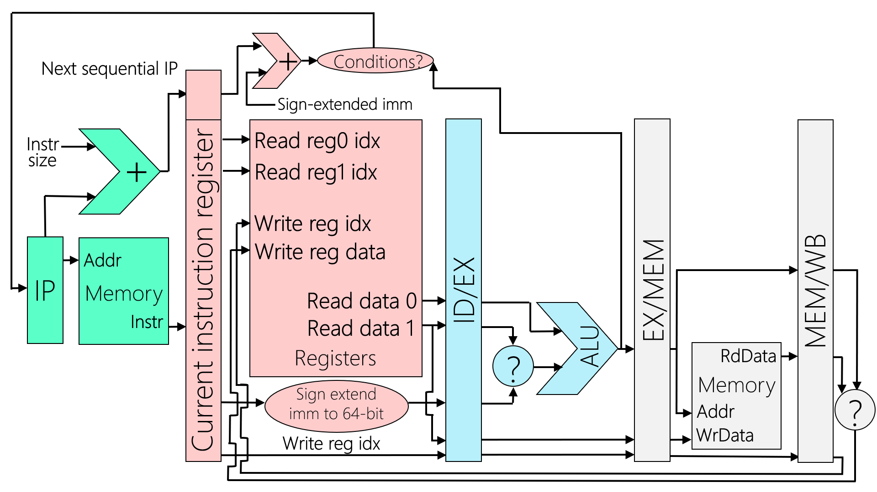
The Problem with Branches
We don’t know if a branch is taken until the end of the decode stage . . .
. . . which means that the fetch stage may have fetched the wrong instruction!
IF
ID
EX
MEM
WB
cmpq %r8, %r9
jz lbl
subq %r10, %r11
. . .
movq 8(%r9), %r12
t=0
cmpq
t=1
jz
cmpq
lbl:
t=2
subq
jz
cmpq
We don’t know whether we should branch until the end of t=2 . . .
. . . so we don’t know whether movq should have been fetched until end of t=2!
subq %r10, %r11
jz lbl
cmpq %r8, %r9
Notes:
The cmpq instruction has to perform an arithmetic operation to determine which condition flags to set. So, the conditions flags can’t be tested by the jz instruction until the end of the cycle in which the cmpq instruction executes. The reason is that the output of the cmpq has to travel along the wire that goes from the ALU to the “conditions” oval.

Slide 37
The Problem with Branches
One solution: Processor automatically inserts a nop after each branch
A nop (“no operation”) does not change the processor’s state
So, executing a nop never affects correctness (although it does slow down the program due to a wasted processor cycle)
IF
ID
EX
MEM
WB
cmpq %r8, %r9
jz lbl
subq %r10, %r11
. . .
movq 8(%r9), %r12
t=0
cmpq
t=1
jz
cmpq
lbl:
t=2
nop
jz
cmpq
t=3
subq or
nop
jz
cmpq
movq
At beginning of t=3, IF uses output of ID from t=2 to fetch the appropriate instruction

Slide 38
The Problem with Branches
Modern processors use table-driven branch prediction
Key: Address of a branch instruction
Value: Prediction about whether the branch will be taken
When ID encounters a branch, ID consults the table to determine whether to feed IF the next sequential IP or the jump target
When EX encounters a branch:
EX resolves the branch test and updates the prediction table
Flushes the pipeline and resets IP if the previous prediction was wrong
IF
ID
EX
MEM
WB
t=0
cmpq
t=1
jz
cmpq
t=2
subq or
jz
cmpq
movq
ID consults table and sets IP appropriately
No need for a pipeline bubble!
CORRECT PREDICTION

Slide 39
The Problem with Branches
Modern processors use table-driven branch prediction
Key: Address of a branch instruction
Value: Prediction about whether the branch will be taken
When ID encounters a branch, ID consults the table to determine whether to feed IF the next sequential IP or the jump target
When EX encounters a branch:
EX resolves the branch test and updates the prediction table
Flushes the pipeline and resets IP if the previous prediction was wrong
IF
ID
EX
MEM
WB
t=0
cmpq
t=1
jz
cmpq
t=2
Wrong
jz
cmpq
instr
ID consults table and sets IP to the address of the wrong instruction
t=3
Right
nop
jz
cmpq
instr
The error is detected here
Wrong instruction erased
INCORRECT PREDICTION

