Slide 1

NFS: A Networked File System
CS 161: Lecture 15
3/27/19

Slide 2
A Brief Overview of Sockets
A socket is a file descriptor that allows a program to send and receive network data
  Socket-specific incantations are needed to create a socket
  Afterwards, read(int fd, . . .) and write(int fd,. . .) can be used
Here’s a (slightly simplified) example:
Server
Client
int l_sock = socket(/*TCP*/);
bind(l_sock, /*network addr
*of server*/);
listen(l_sock);
int c_sock = accept(l_sock);
read(c_sock, buf, 4);
write(c_sock, buf, 5);
close(c_sock);
int sock = socket(/*TCP*/);
connect(sock, /*network addr
*of server*/);
write(sock, buf, 4);
read(sock, buf, 5);
close(sock);
Notes:
Sockets are similar to pipes. To create a pipe, you have to invoke a pipe-specific method call pipe(). To create a socket, you have to call a socket-specific method called socket(). Note that a socket file descriptor allows for reading and writing; this contrasts with a pipe, where one file descriptor is for writing, and another is for reading.

Slide 3

The VFS Layer
VFS decouples the POSIX file system interface from an underlying implementation of that interface
Application-specific code
libc
syscall
interface
VFS
ext3
ext4
btrfs
NFS
Network
Local
Local
Local
Remote
storage
storage
storage
storage

Slide 4
The VFS Layer
VFS decouples the POSIX file system interface from an underlying implementation of that interface
Why use a network
file system?
Application-specific code
Make cross-user data sharing easier
Outsource administration (e.g., data backup)
Improve data availability by storing it on well-maintained servers instead of flaky client machines
libc
syscall
interface
VFS
ext3
ext4
btrfs
NFS
Network
Local
Local
Local
Remote
storage
storage
storage
storage

Slide 5
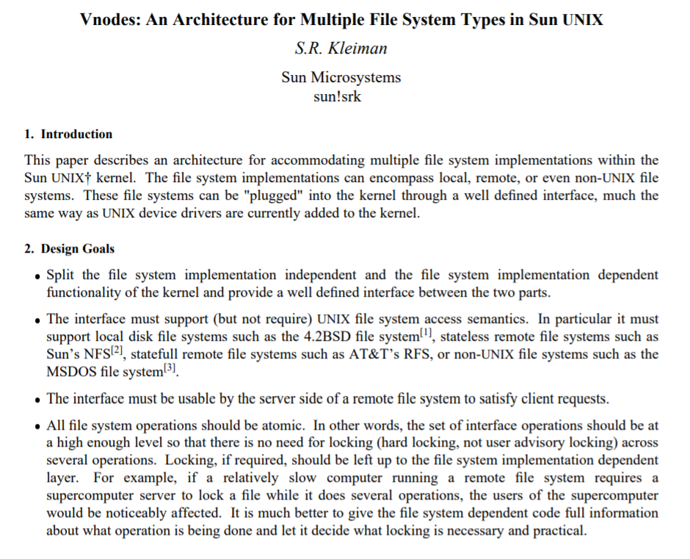
NFS was a primary motivation for the development of the VFS layer!

Slide 6

NFS: One Possible Design
Implement the NFS server as user-mode process on server!
  Use a traditional local file system (e.g., ext4) to actually store data
  Mirror client-side file descriptors using server-side file descriptors
It’s good to avoid kernel implementations if possible
  Kernel bugs affect system-wide stability and security
  Also, kernel programming is hard
YOU KNOW THIS PERSONALLY

Slide 7
NFS: One Possible Design
fd = open(“/foo.txt”)
Application
NFS server
libc
libc
App fd table
VFS
VFS
Network
Network
NFS client
stack
stack
ext4
in/out/err
NEW_NFS_CLIENT;
OPEN<“/foo.txt”>;
socket
Network
local: 52.3.0.7:2391
remote: 71.3.3.9:8220
Local storage
Notes:
Note that the socket is not visible to the application-level code; in other words, the socket is owned by the NFS client. This is why we don’t see the socket being pointed to by the application’s file descriptor table.

Slide 8
NFS: One Possible Design
fd = open(“/foo.txt”)
fd = open(“/foo.txt”)
fork()
Application
NFS server
NFS child
After some dup() and close() shenanigans...
libc
libc
App fd table
VFS
VFS
NFS child fd table
Network
Network
NFS client
stack
stack
ext4
in/out/err
in/out/err
NEW_NFS_CLIENT;
OPEN<“/foo.txt”>;
name: “/foo.txt”
pos: 0
socket
socket
Network
local: 71.3.3.9:8220
local: 52.3.0.7:2391
remote: 52.3.0.7:2391
remote: 71.3.3.9:8220
Local storage

Slide 9
NFS: One Possible Design
fd = open(“/foo.txt”)
fd = open(“/foo.txt”)
Application
NFS server
NFS child
libc
libc
App fd table
VFS
VFS
NFS child fd table
Network
Network
NFS client
stack
stack
ext4
in/out/err
in/out/err
name: “/foo.txt”
name: “/foo.txt”
pos: 0
OPEN_OK(“/foo.txt”);
pos: 0
socket
socket
Network
local: 71.3.3.9:8220
local: 52.3.0.7:2391
remote: 52.3.0.7:2391
remote: 71.3.3.9:8220
Local storage

Slide 10
NFS: One Possible Design
fd = open(“/foo.txt”)
read(fd, buf, 10);
fd = open(“/foo.txt”)
read(fd, buf, 10);
Application
NFS server
NFS child
libc
libc
App fd table
VFS
VFS
NFS child fd table
Network
Network
NFS client
stack
stack
ext4
in/out/err
in/out/err
name: “/foo.txt”
name: “/foo.txt”
pos: 0
READ<fd, 10>;
pos: 0
socket
socket
Network
local: 71.3.3.9:8220
local: 52.3.0.7:2391
remote: 52.3.0.7:2391
remote: 71.3.3.9:8220
Local storage

Slide 11
NFS: One Possible Design
fd = open(“/foo.txt”)
read(fd, buf, 10);
fd = open(“/foo.txt”)
read(fd, buf, 10);
Application
NFS server
NFS child
libc
libc
App fd table
VFS
VFS
NFS child fd table
Network
Network
NFS client
stack
stack
ext4
in/out/err
in/out/err
name: “/foo.txt”
name: “/foo.txt”
pos: 0
READ_OK<data>;
pos: 10
pos: 10
pos: 0
socket
socket
Network
local: 71.3.3.9:8220
local: 52.3.0.7:2391
remote: 52.3.0.7:2391
remote: 71.3.3.9:8220
Local storage

Slide 12
NFS: One Possible Design
fd = open(“/foo.txt”)
read(fd, buf, 10);
read(fd, buf, 20);
fd = open(“/foo.txt”)
read(fd, buf, 10);
read(fd, buf, 20);
Application
NFS server
NFS child
libc
libc
App fd table
VFS
VFS
NFS child fd table
Network
Network
NFS client
stack
stack
ext4
in/out/err
in/out/err
name: “/foo.txt”
name: “/foo.txt”
pos: 10
READ<fd, 20>;
pos: 10
socket
socket
Network
local: 71.3.3.9:8220
local: 52.3.0.7:2391
remote: 52.3.0.7:2391
remote: 71.3.3.9:8220
Local storage

Slide 13
NFS: One Possible Design
fd = open(“/foo.txt”)
read(fd, buf, 10);
read(fd, buf, 20);
fd = open(“/foo.txt”)
read(fd, buf, 10);
read(fd, buf, 20);
Application
NFS server
NFS child
libc
libc
App fd table
VFS
VFS
NFS child fd table
Network
Network
NFS client
stack
stack
ext4
in/out/err
in/out/err
name: “/foo.txt”
name: “/foo.txt”
pos: 10
READ_OK<data>;
pos: 30
pos: 30
pos: 10
socket
socket
Network
local: 71.3.3.9:8220
local: 52.3.0.7:2391
remote: 52.3.0.7:2391
remote: 71.3.3.9:8220
Local storage

Slide 14
NFS: One Possible Design
fd = open(“/foo.txt”)
read(fd, buf, 10);
read(fd, buf, 20);
close(fd);
fd = open(“/foo.txt”)
read(fd, buf, 10);
read(fd, buf, 20);
close(fd);
Application
NFS server
NFS child
libc
libc
App fd table
VFS
VFS
NFS child fd table
Network
Network
NFS client
stack
stack
ext4
in/out/err
in/out/err
name: “/foo.txt”
name: “/foo.txt”
pos: 30
CLOSE<fd>;
pos: 30
socket
socket
Network
local: 71.3.3.9:8220
local: 52.3.0.7:2391
remote: 52.3.0.7:2391
remote: 71.3.3.9:8220
Local storage

Slide 15
NFS: One Possible Design
fd = open(“/foo.txt”)
read(fd, buf, 10);
read(fd, buf, 20);
close(fd);
fd = open(“/foo.txt”)
read(fd, buf, 10);
read(fd, buf, 20);
close(fd);
Application
NFS server
NFS child
libc
libc
App fd table
VFS
VFS
NFS child fd table
Network
Network
NFS client
stack
stack
ext4
in/out/err
in/out/err
name: “/foo.txt”
pos: 30
CLOSE_OK<fd>;
socket
socket
Network
local: 71.3.3.9:8220
local: 52.3.0.7:2391
remote: 52.3.0.7:2391
remote: 71.3.3.9:8220
Local storage

Slide 16
NFS: One Possible Design
This design uses a stateful server
  Server has a mirror of client-side file descriptor state
  Client commands reference that state; e.g., READ<fd, 20>
    Explicitly references the file descriptor fd
    Implicitly references the seek position pos
What happens if the server crashes and then reboots between the first and second read()s?

Slide 17
fd = open(“/foo.txt”)
read(fd, buf, 10);
read(fd, buf, 20);
ERROR: No matching local socket!
Application
NFS server
libc
libc
App fd table
VFS
VFS
Network
Network
NFS client
stack
stack
ext4
in/out/err
name: “/foo.txt”
pos: 10
READ<fd, 20>;
socket
Network
local: 52.3.0.7:2391
remote: 71.3.3.9:8220
Local storage

Slide 18
Suppose that the NFS server spawns a new child after detecting an unexpected NFS command . . .

Slide 19
fd = open(“/foo.txt”)
read(fd, buf, 10);
read(fd, buf, 20);
ERROR: No matching fd!
READ<fd, 20>
Application
NFS server
NFS server
NFS child
libc
libc
App fd table
VFS
VFS
NFS child fd table
Network
Network
NFS client
stack
stack
ext4
in/out/err
in/out/err
name: “/foo.txt”
pos: 10
READ<fd, 20>;
socket
socket
Network
local: 71.3.3.9:8220
local: 52.3.0.7:2391
remote: 52.3.0.7:2391
remote: 71.3.3.9:8220
Local storage

Slide 20
Protocol Design: Stateful vs. Stateless
Stateful protocol: Client and server have to maintain a consistent view of shared state
  Advantage: Network messages can be small because additional state (e.g., seek position) is implicitly present on client and server
  Disadvantage: Crash recovery is challenging due to state desynchronization
Stateless protocol: Each request contains all of the information needed to satisfy the request
  Ex: An HTTP request specifies a resource name (i.e., URL) and must explicitly include additional session state (e.g., via cookies)
  Ex: The real NFSv3 protocol is stateless

Slide 21
The Real NFSv3 Protocol

Slide 22
The Core Protocol
An NFS handle specifies a file to manipulate
  From a server’s perspective, a handle is logically similar to the two-tuple <inode_num, inode_version>
    Server increments the version number when an inode is reused
    Ensures that a client with a handle to old version of file cannot access new version
  From client’s perspective, the handle is an opaque value (max=64 bytes)
Important NFS commands:
MOUNT //Get handle for root directory “/”
LOOKUP dir_fh, name //Return handle for a file or
//directory contained in parent
//directory pointed to by dir_fh
READ fh, offset, count //Read some data
WRITE fh, offset, count, data //Write some data
Notes:
[Ref: https://tools.ietf.org/html/rfc1813]

Slide 23
The Core Protocol
An NFS handle specifies a file to manipulate
  From a server’s perspective, a handle is logically similar to the two-tuple <inode_num, inode_version>
    Server increments the version number when an inode is reused
    Ensures that a client with a handle to old version of file cannot access new version
  From client’s perspective, the handle is an opaque value (max=64 bytes)
Important NFS commands:
Each request embeds all of the information needed to satisfy the request
  Ex: LOOKUP assumes that the caller has already acquired the handle for the prefix of the path to look up
  Ex: NFS’s READ and WRITE specify explicit file offsets, unlike the equivalent POSIX commands
No NFS “open” or “close” command: server-side statelessness!
MOUNT //Get handle for root directory “/”
LOOKUP dir_fh, name //Return handle for a file or
//directory contained in parent
//directory pointed to by dir_fh
READ fh, offset, count //Read some data
WRITE fh, offset, count, data //Write some data

Slide 24
NFSv3
fd = open(“/foo.txt”)
Application
NFS server
libc
libc
App fd table
VFS
VFS
Network
Network
NFS client
stack
stack
ext4
in/out/err
MOUNT
socket
Network
local: 52.3.0.7:2391
remote: 71.3.3.9:8220
Local storage

Slide 25
NFSv3
fd = open(“/foo.txt”)
Application
NFS server
libc
libc
App fd table
VFS
VFS
Network
Network
NFS client
stack
stack
ext4
in/out/err
MOUNT_OK:fh“/”
socket
Network
local: 52.3.0.7:2391
remote: 71.3.3.9:8220
Local storage

Slide 26
NFSv3
fd = open(“/foo.txt”)
Application
NFS server
libc
libc
App fd table
VFS
VFS
Network
Network
NFS client
stack
stack
ext4
in/out/err
LOOKUP fh“/”, “foo.txt”
socket
Network
local: 52.3.0.7:2391
remote: 71.3.3.9:8220
Local storage

Slide 27
NFSv3
fd = open(“/foo.txt”)
Application
NFS server
libc
libc
App fd table
VFS
VFS
Network
Network
NFS client
stack
stack
ext4
in/out/err
name: “/foo.txt”
pos: 0
LOOKUP_OK:fh_{“/foo.txt”}
socket
Network
local: 52.3.0.7:2391
remote: 71.3.3.9:8220
Local storage

Slide 28
NFSv3
fd = open(“/foo.txt”)
read(fd, buf, 10);
Application
NFS server
libc
libc
App fd table
VFS
VFS
Network
Network
NFS client
stack
stack
ext4
in/out/err
name: “/foo.txt”
READ fh_{“/foo.txt”}, 0, 10
pos: 0
socket
Network
local: 52.3.0.7:2391
remote: 71.3.3.9:8220
Local storage

Slide 29
NFSv3
fd = open(“/foo.txt”)
read(fd, buf, 10);
Application
NFS server
libc
libc
App fd table
VFS
VFS
Network
Network
NFS client
stack
stack
ext4
in/out/err
name: “/foo.txt”
READ_OK<data>
pos: 0
pos: 10
socket
Network
local: 52.3.0.7:2391
remote: 71.3.3.9:8220
Local storage

Slide 30
NFSv3
fd = open(“/foo.txt”)
read(fd, buf, 10);
read(fd, buf, 20);
Application
NFS server
libc
libc
App fd table
VFS
VFS
Network
Network
NFS client
stack
stack
ext4
in/out/err
name: “/foo.txt”
READ fh_{“/foo.txt”}, 10, 20
pos: 10
socket
Network
local: 52.3.0.7:2391
remote: 71.3.3.9:8220
Local storage

Slide 31
NFSv3
fd = open(“/foo.txt”)
read(fd, buf, 10);
read(fd, buf, 20);
Application
NFS server
libc
libc
App fd table
VFS
VFS
Network
Network
NFS client
stack
stack
ext4
in/out/err
name: “/foo.txt”
READ_OK<data>
pos: 10
pos: 30
socket
Network
local: 52.3.0.7:2391
remote: 71.3.3.9:8220
Local storage

Slide 32

NFSv3
fd = open(“/foo.txt”)
read(fd, buf, 10);
read(fd, buf, 20);
close(fd)
Application
NFS server
libc
libc
App fd table
VFS
VFS
Network
Network
NFS client
stack
stack
ext4
in/out/err
name: “/foo.txt”
No NFS command
Not always true;
pos: 30
sent!
see upcoming
socket
discussion of
Network
local: 52.3.0.7:2391
caching!
remote: 71.3.3.9:8220
Local storage

Slide 33
Server Crashes and Network Disruptions
A client retransmits an NFS request if the server does not respond before a timer fires (default timeout: 60 seconds)
Most NFS operations are idempotent: they will do the same thing if executed multiple times
  Read-only operations (e.g., LOOKUP and READ) are trivially idempotent
  WRITE is also idempotent, since the offset and data are explicitly provided

Slide 34
Server Crashes and Network Disruptions
What about non-idempotent operations (e.g., MKDIR and RMDIR)?
  NFS server has a duplicate request cache of recently-received non-idempotent requests
  If server receives a non-idempotent request that hits in the cache, the server doesn’t execute the request
  Instead, the server responds with the return value of the original request
If the duplicate request cache is too small, then non-idempotent requests may be replayed :-(
If the duplicate request cache is only stored in RAM, then it only protects against transient network faults, not server crashes :-(

Slide 35
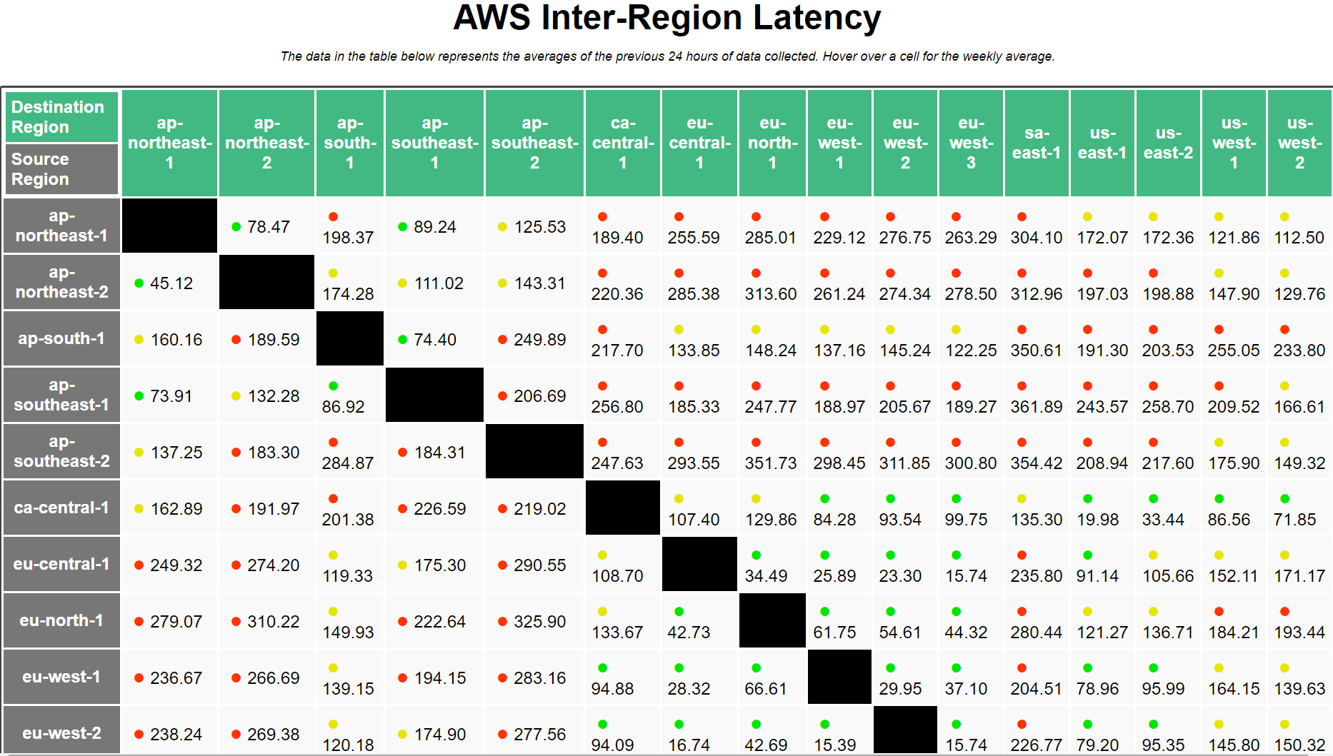
The Costs of Accessing Remote Storage
Network latencies might be worse than local storage IO latencies
  SSD access latency: ~30μs—1.5ms
  Disk access latency: ~6ms—17ms
  Local area round-trip time: ~200μs—3ms
  Wide area round-trip time: Let’s look at https://www.cloudping.co/ . . .
Notes:
“ap” means “Asia/Pacific.” “sa” means “South America.” “eu” means “Europe.” “ca” means “Canada,” and “us” means “United States.”

Slide 36
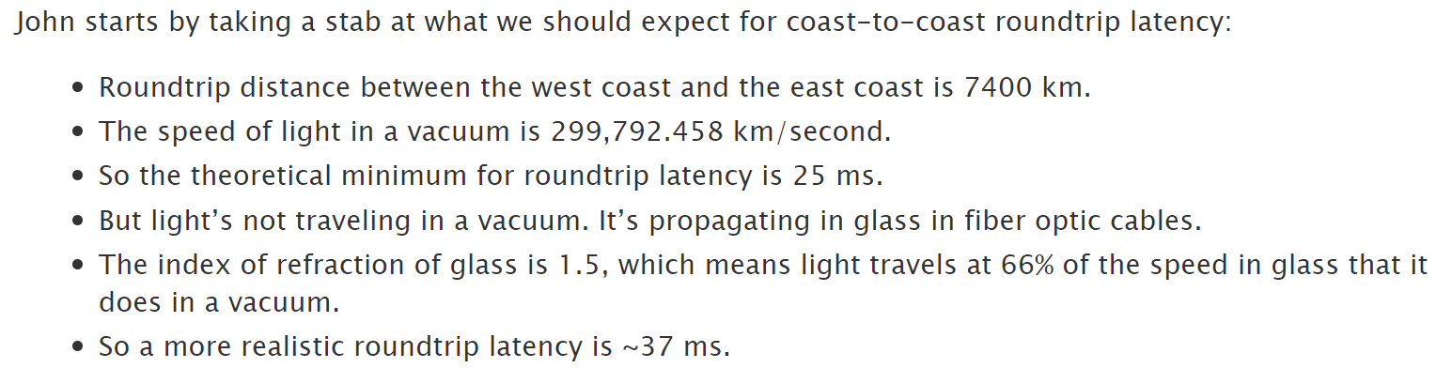




Notes:
us-west-1 is in California. us-east-1 is in Virginia.
[Ref: https://www.stevesouders.com/blog/2010/07/13/velocity-tcp-and-the-lower-bound-of-web-performance/
https://docs.aws.amazon.com/AWSEC2/latest/UserGuide/using-regions-availability-zones.html]

Slide 37
Client-side Caching
To hide network latencies, NFS clients aggressively cache data
  Data read from server is cached and used to satisfy later reads
  Writes hit the cache first; are immediately acknowledged to VFS layer
    NFS client lazily writes dirty blocks to server
    NFS protocol does not requires a specific write-back order!
Alice
Bob
Charlie
Reads foo.txt_{v0}
Reads foo.txt_{v0}
Writes to foo.txt_{v0},
Time
creating foo.txt_{v1}
Reads foo.txt_{v0}
(stale cache!)
Reads foo.txt_{v0}
(stale server copy!)
Writes dirty foo.txt_{v1}
blocks to server

Slide 38
Improving Data Consistency
NFS leverages two techniques to improve consistency
  Flush-on-close(): NFS client always writes dirty blocks to server upon close()
  Cached block validation
    Periodically (e.g., every 15 seconds), the client issues a GETATTR command to check whether the server has received new writes for client-cached blocks
    Client drops invalidated blocks
This doesn’t totally fix the consistency problem!
  If a reader and a writer use a local file system, a write to a block is immediately visible to the reader
  NFS doesn’t provide this property, even with flush-on-close() and cached block validation
  Client applications can invoke fsync(int fd) to force NFS to write a file’s dirty pages to server
Notes:
[As described by the man page for fsync(), “fsync() transfers (‘flushes’) all modified in-core data of (i.e., modified buffer cache pages for) the file referred to by the file descriptor fd to the disk device (or other permanent storage device) so that all changed information can be retrieved even after the system crashed or was rebooted. This includes writing through or flushing a disk cache if present.” [Ref: https://linux.die.net/man/2/fsync]]

Slide 39
User-mode NFS Servers: Generating File Handles
stat(const char *path, struct stat *st) syscall puts inode number in st.ino_t
  However, stat() doesn’t expose inode versions . . .
  . . . so, in olden times, a user-mode NFS server had to track file deletions and creations, and maintain an inode-to-version table
Most modern NFS servers are completely in-kernel
However, Linux added two syscalls to specifically aide stateless user-mode file servers
NFS server
libc
VFS
Network
stack
ext4
Local storage
Notes:
Moving to an in-kernel implementation avoids the expensive context switches that are incurred by a user-mode implementation! For example, if the NFS server lives in the kernel, then the server can transfer data from the disk to the network stack without having to make a transition up to user-level and then back down to the kernel level.

Slide 40
User-mode NFS Servers: Generating File Handles
//Returns an opaque handle representing the specified file;
//a handle becomes invalid if the file is deleted.
int name_to_handle_at(const char *pathname,
struct file_handle *handle,
...);
//Opens the file associated with a handle, returning an integer
//file descriptor.
int open_by_handle_at(struct file_handle *handle, ...);
Notes:
[FreeBSD supports analogues of name_to_handle_at() and open_by_handle_at(): getfh() and openfh().]
[Refs: https://linux.die.net/man/2/stat
https://www.kernel.org/doc/Documentation/filesystems/nfs/Exporting
https://github.com/tinganho/linux-kernel/blob/master/fs/fhandle.c
https://elixir.bootlin.com/linux/v4.9.12/source/fs/exportfs/expfs.c#L393
https://linux.die.net/man/8/exportfs]

Slide 41
User-mode NFS Servers: Generating File Handles
//For a local file system to be exposed to remote clients
//via a local NFS server, the local file system must define
//export operations . . .
struct super_block {
unsigned long s_blocksize;
const struct export_operations *s_export_op;
//...other stuff...
};
struct export_operations {
int (*encode_fh)(struct inode *inode, __u32 *fh, ...);
struct dentry* (*fh_to_dentry)(struct super_block *sb,
struct fid *fid, ...);
//...other stuff...
};
Wrapper struct that points to in-memory inode
Notes:
[Ref: https://elixir.bootlin.com/linux/latest/source/include/linux/exportfs.h#L134
https://linux.die.net/man/8/exportfs]

