Slide 1
Scheduling
CS 161: Lecture 18
4/10/19

Slide 2
Scheduling: Which Process Should Run Now?
Different processes have different behaviors
IO-bound: A process mostly waits for IOs to complete
CPU-bound: A process issues few IOs, mostly does computation
A process may change its behavior throughout its execution—the scheduler must notice and adjust!
Often a good idea to prioritize IO-bound processes
Allow tasks blocked on user input, network, etc. to respond quickly and initiate new (and slow!) IOs if necessary

Slide 3
Ex: An IO-bound disk grep, and a CPU-bound crypto calculation on a single-core machine
Crypto task finishes
Non-preemptive
first-come-first-serve
Crypto
CPU
screws IO-bound tasks
Waiting
Waiting on CPU :-(
Waiting
Waiting
Grep
on IO
on IO
on IO
Time
Crypto
CPU
CPU
CPU
Preempting
CPU-bound tasks
for IO-bound ones
Waiting
Waiting
Waiting
Grep
on IO
on IO
on IO
improves utilization
of CPU and IO devices
Time

Slide 4
Evaluating Scheduler Algorithms
Utilization
How often are the CPUs and IO devices kept busy?
Note that CPUs and IO devices can simultaneously be busy (which is good!)
Fairness
Higher-priority tasks should receive more CPU time . . .
. . . but no task should starve
Interactive latency
A task that mostly blocks on IO should run as soon as IO completes
Ex: Text editor waiting on keypress
Computational overhead of the scheduler as a function of:
The number of CPUs
The number of runnable tasks
The number of waiting tasks

Slide 5
Priority-based Round-Robin
Scheduler
(priority-deque)
Priority queues
Idea: Maintain several ready queues, one for each priority level
Each queue is FIFO
Scheduler finds highest-priority non-empty queue and runs the first task in that queue
Good: Allows higher-priority tasks to receive more CPU time
Bad: Low-priority tasks may starve!
Solution: aging (the longer a task waits without getting the CPU, the higher its priority becomes)
Bad: IO-bound tasks may suffer long response times if not given high priorities
Bad: Priority inversion
Blocking
operation
or
timer
Enqueue
Wait queues

Slide 6
Priority Inversion
I HAZ A PRIORITY INVERSION
Assume that a system has three tasks T1, T2, and T3
Priority: T3 > T2 > T1
Imagine that T1 and T3 both use the same lock . . .
T3
Waiting on IO
Running
Waiting on lock
Waiting on lock
T3 is the highest
Tries to acquire lock
priority thread,
T2
Waiting on IO
Running
but it’s blocked
Ready
Running
by T2 and T1!
T1
Running
Waiting on IO
Ready
Ready
Time
Acquires lock
Notes:
[Ref: http://www.cse.chalmers.se/edu/year/2015/course/EDA222/Documents/Misc/Report_MarsPathFinder.pdf
http://research.microsoft.com/en-us/um/people/mbj/Mars_Pathfinder/Mars_Pathfinder.html
http://space.stackexchange.com/a/9181]

Slide 7
Priority Inheritance
A task which owns a lock inherits the highest priority of any task that wishes to acquire the lock
T3
Waiting on IO
Running
Waiting on lock
Running
Tries to acquire lock
Acquires lock
T2
Waiting on IO
Ready
Ready
Ready
T1
Running
Waiting on IO
Running
Ready
Time
Acquires lock
Inherits T3’s priority
Releases lock, drops priority

Slide 8
Linux’s “Completely Fair Scheduler” (CFS)
For now, make these simplifying assumptions:
There is only one CPU
All tasks have the same priority
There are always T tasks ready to run at any moment
Basic idea: each task gets 1/T of the CPU’s resources
CFS tries to model an “ideal CPU” that runs each task simultaneously, but at 1/T the CPU’s clock speed
A real CPU can only run a single task at once, so a task will get “ahead” or “behind” of its 1/T allotment
CFS tracks how long each task has actually run; during a scheduling decision (e.g., timer interrupt), picks the task with lowest runtime so far
Notes:
[Ref: https://www.kernel.org/doc/Documentation/scheduler/sched-design-CFS.txt]

Slide 9
Red-black
10
binary trees
3
13
0
7
15
5
8
Self-balancing: Insertions and deletions ensure that the longest tree path is at most twice the length of any other path
Guaranteed logarithmic: All insertions, deletions, and searches run in O(log N) time

Slide 10
t
3
23
CFS scheduler
t
t
5
0
Associate each task with its elapsed runtime (nanosecond granularity)
For each core, store runnable tasks in a red-black tree, with an insertion key of elapsed runtime
A newly-created task is tagged with the minimal runtime in the tree
Next task to run is just the left-most task in tree!
7
37
t
1
5
15
42
t
t
2
4
Scheduler picks this task to run, removes it from tree
Notes:
A newly-created task is tagged with the minimal runtime in the tree. By doing this, we ensure two things: first, we ensure that the task will get a CPU burst very soon in the future. However, we also ensure that the task doesn’t then hog the CPU for a long time---soon, the other task with the minimal runtime will get to run.

Slide 11
t
3
23
t
t
5
0
7
37
t
1
15
42
Timer interrupt fires, scheduler runs
t
4
Now, t₂ no longer has the smallest elapsed runtime
So, scheduler reinserts t₂ into the tree and runs t₀!
5
Runs for 20 time units
25
t
t
2
2

Slide 12
Classic CFS Example
Suppose there are two tasks:
Video rendering application (CPU-intensive, long-running, non-interactive)
Word processor (interactive, only uses CPU for bursts)
Both tasks start with an elapsed runtime of 0
Video rendering task quickly accumulates runtime . . .
. . . but word processor’s runtime stays low (task is mainly blocked on IO)
So, whenever word processor receives keyboard/mouse input and wakes up, it will be the left-most task, and immediately get scheduled

Slide 13
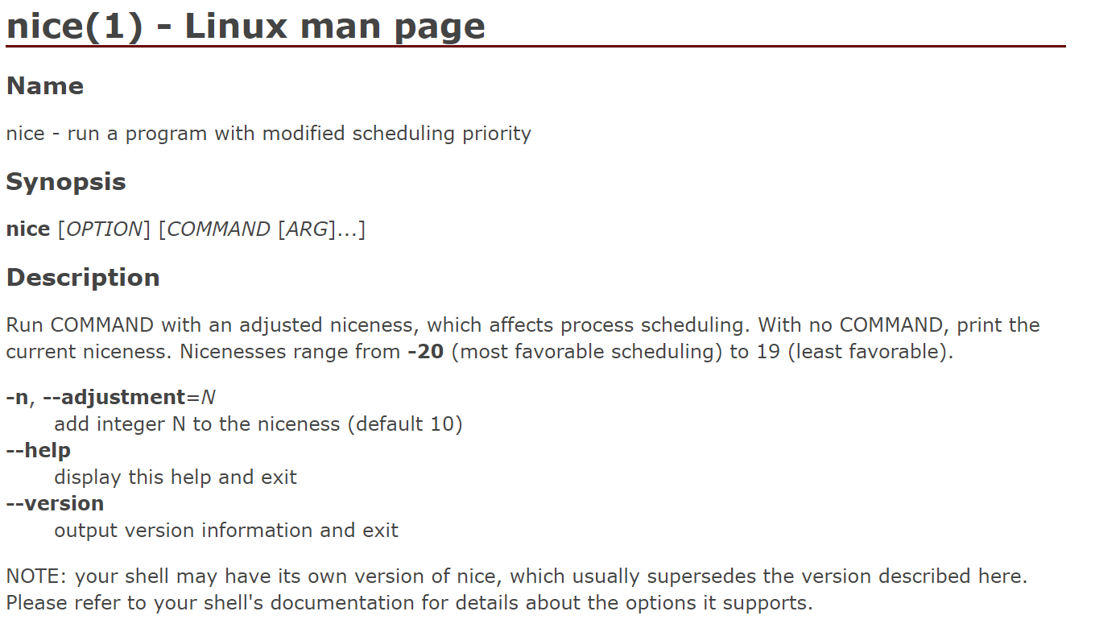
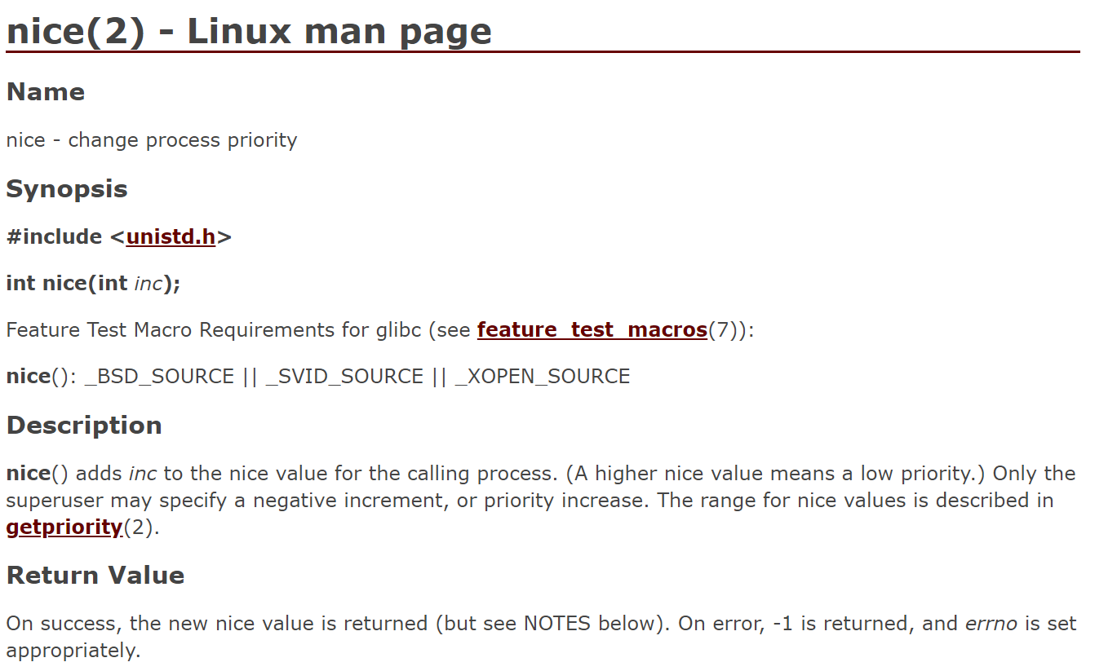
It’s Nice To Be Nice

Slide 14
Task Priorities in CFS
/*
* Nice levels are multiplicative, with a gentle 10% change for every
* nice level changed. I.e. when a CPU-bound task goes from nice 0 to
* nice 1, it will get ~10% less CPU time than another CPU-bound task
* that remained on nice 0.
*
* The "10% effect" is relative and cumulative: from _any_ nice level,
* if you go up 1 level, it's -10% CPU usage, if you go down 1 level
* it's +10% CPU usage. (to achieve that we use a multiplier of 1.25.
* If a task goes up by ~10% and another task goes down by ~10% then
* the relative distance between them is ~25%.)
*/
static const int prio_to_weight[40] = {
/* -20 */ 88761, 71755, 56483, 46273, 36291,
/* -15 */ 29154, 23254, 18705, 14949, 11916,
/* -10 */ 9548, 7620, 6100, 4904, 3906,
/* -5 */ 3121, 2501, 1991, 1586, 1277,
/* 0 */ 1024, 820, 655, 526, 423,
/* 5 */ 335, 272, 215, 172, 137,
/* 10 */ 110, 87, 70, 56, 45,
/* 15 */ 36, 29, 23, 18, 15,
};
Notes:
Note that there is an entry in the array for each possible nice value.

Slide 15
Task Priorities in CFS
CFS incorporates nice values by scaling a task’s elapsed runtime
The end result is that:
[nice=0] Virtual execution time equals physical execution time
[nice<0] Virtual execution time less than physical execution time
[nice>0] Virtual execution time greater than physical execution time
curr->vruntime is used as a task’s key in the RB tree
delta_exec = now – curr->exec_start;
delta_exec_weighed = delta_exec *
(NICE_0_LOAD / t->load.weight);
curr->vruntime += delta_exec_weighted;

Slide 16
Making Scheduling Efficient
Linux scheduler (circa v2.4)
The runqueue wasn’t sorted!
Newly-runnable processes added to the end: O(1)
Finding the best process to run required linear scan: O(n)
O(n) scheduling was kinda tolerable on a single-core machine, but generated a lot of lock contention on multi-core machines
t
1
Global runnable queue
t
2
t
3
…
Single spinlock
t
4
Scheduler logic

Slide 17
Linux scheduler now: CFS
Uses a red-black tree per core, to avoid cross-core lock contention
However, cross-core load balancing is needed to ensure:
All cores are highly-utilized
All of the high-priority tasks don’t end up on a small number of cores
Scheduler logic
Scheduler logic
Scheduler logic
Scheduler logic
Notes:
Note that load-balancing tasks across the red-black trees is tricky to implement efficiently. The reason is that moving a task from one tree to another requires the acquisition of locks on the associated trees. The entire point of using per-core scheduling structures is to avoid the acquisition of non-local locks!

Slide 18
Scheduler Groups in Linux
Linux supports multiple simultaneous schedulers!
A kernel-visible thread has:
A static priority from 0 (low; default) to 99 (high)
A scheduling class
Each static priority level has an associated runqueue:
Priority level 0: always handled by CFS, so the runqueue is a red-black tree
“Real time” priority levels 1—99: an actual queue
Scheduler logic
99
FIFO
RR
FIFO
98
97
FIFO
RR
FIFO
96
RR
RR
RR
Select the “front-most” task in the highest-priority, non-empty runqueue
. . .
1
RR
FIFO
0
Notes:
Why do we say “static” priority instead of just “priority”? The reason is that the a thread in a CFS runqueue has a static priority of 0, as well as a DYNAMIC priority that changes over time. The dynamic priority is the vruntime that we discussed a few slides ago!
[Ref: http://man7.org/linux/man-pages/man7/sched.7.html
https://github.com/tinganho/linux-kernel/blob/master/kernel/sched.c#L4195]

Slide 19
Scheduler Groups in Linux
SCHED_OTHER class
By default, a thread receives this class
A running SCHED_OTHER thread is always immediately preempted by a SCHED_RR or SCHED_FIFO thread if such a thread becomes runnable
“Front-most” means “lowest vruntime”
Scheduler logic
99
FIFO
RR
FIFO
98
97
FIFO
RR
FIFO
96
RR
RR
RR
Select the “front-most” task in the highest-priority, non-empty runqueue
. . .
1
RR
FIFO
0

Slide 20
Scheduler Groups in Linux
SCHED_FIFO class
When a SCHED_FIFO task becomes runnable, will immediately preempt a running SCHED_OTHER task
A running SCHED_FIFO task that is preempted by a higher priority SCHED_FIFO task remains at the head of its runqueue
When a blocked SCHED_FIFO task becomes runnable, it goes at the end of its runqueue
A SCHED_FIFO task runs until:
It blocks on IO
It calls sched_yield()
It is preempted by a higher priority thread
Scheduler logic
99
FIFO
RR
FIFO
98
97
FIFO
RR
FIFO
96
RR
RR
RR
Select the “front-most” task in the highest-priority, non-empty runqueue
. . .
1
RR
FIFO
0

Slide 21
Scheduler Groups in Linux
SCHED_RR class
A SCHED_RR thread is like a SCHED_FIFO thread, but can only execute for a maximum time quantum
To read/write the quantum: /proc/sys/kernel/sched_rr_timeslice_ms
Scheduler logic
99
FIFO
RR
FIFO
98
97
FIFO
RR
FIFO
96
RR
RR
RR
Select the “front-most” task in the highest-priority, non-empty runqueue
. . .
1
RR
FIFO
0
Notes:
Nice values only apply to tasks being scheduled with CFS.
[Ref: http://man7.org/linux/man-pages/man2/sched_rr_get_interval.2.html]

Slide 22
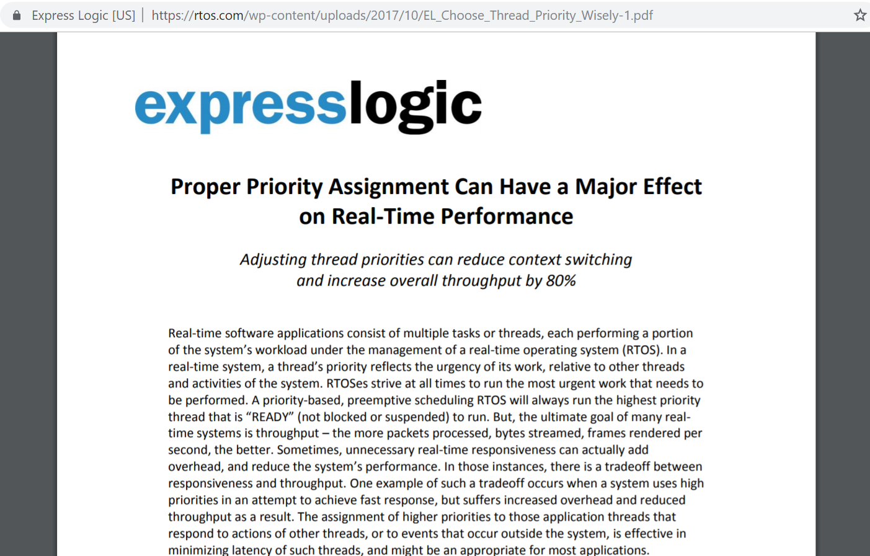
Which Priorities Should I Assign To My Tasks?
Notes:
[Ref: https://rtos.com/wp-content/uploads/2017/10/EL_Choose_Thread_Priority_Wisely-1.pdf]

Slide 23
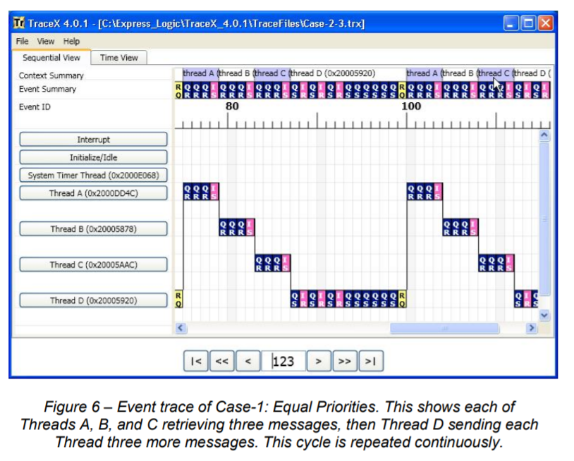
Suppose that there are four threads: A, B, C, and D
Threads A, B, and C are message receivers, repeatedly blocking until a message from Thread D arrives
Thread D repeatedly:
Sends a message to A, B, C
Sends a message to A, B, C
Sends a message to A, B, C
Yields
If each thread has the same priority . . .
Notes:
[Ref: https://rtos.com/wp-content/uploads/2017/10/EL_Choose_Thread_Priority_Wisely-1.pdf]

Slide 24
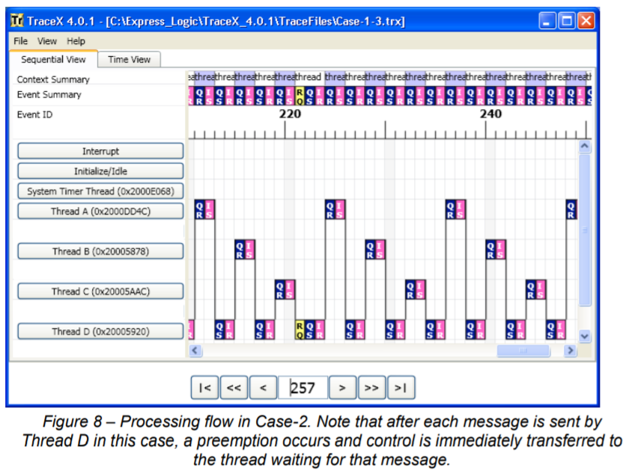
Suppose that there are four threads: A, B, C, and D
Threads A, B, and C are message receivers, repeatedly blocking until a message from Thread D arrives
Thread D repeatedly:
Sends a message to A, B, C
Sends a message to A, B, C
Sends a message to A, B, C
Yields
Pri(A) > Pri(B) > Pri(C) > Pri(D)
Look at all the context switches!

Slide 25
CPU Affinity
struct task_struct{ //From the Linux kernel
volatile long state; //TASK_RUNNING,
//TASK_ZOMBIE,
//etc.
void *stack; //Kernel stack
int exit_code;
struct mm_struct *mm;//Address space info
unsigned long cpus_allowed;
//Bitmask representing which
//cpus the task can run on
...
};
Notes:
Here’s the task_struct that Linux uses. In Linux, the word “task” means “kernel-level thread.”

Slide 26
CPU Affinity
T1: Read data
Socket 0
L1 i-cache
L1 d-cache
L1 i-cache
L1 d-cache
L2 cache
L2 cache
L3 cache
RAM
Socket 1
L1 i-cache
L1 d-cache
L1 i-cache
L1 d-cache
L2 cache
L2 cache
L3 cache
Notes:
Imagine that you want to run an application that has two tasks called T1 and T2.

Slide 27
CPU Affinity
T2: Read data
T1: Read data
Socket 0
L1 i-cache
L1 d-cache
L1 i-cache
L1 d-cache
L2 cache
L2 cache
L3 cache
RAM
Socket 1
L1 i-cache
L1 d-cache
L1 i-cache
L1 d-cache
L2 cache
L2 cache
L3 cache
Notes:
This is nice because T2 can initialize its L1 and L2 caches from the L3 cache on the same socket. This is much faster than having to read the data from RAM and then having to populate the L3, L2, and L1 cache.

Slide 28
CPU Affinity
X
T2: Read data
T1: Read data
Socket 0
L1 i-cache
L1 d-cache
L1 i-cache
L1 d-cache
L2 cache
L2 cache
L3 cache
Scheduler moves T2 to…
Expensive cross-socket fetch!
T2: Read data
RAM
Socket 1
L1 i-cache
L1 d-cache
L1 i-cache
L1 d-cache
L2 cache
L2 cache
L3 cache
Notes:
Now suppose that the scheduler moves T2 from the core on Socket 0 to the core on Socket 1. Now, if T2 reads the data item again, it has to fetch that data over the connection between the two sockets, instead of being able to fetch the data from the L3 cache. Fetching data over the inter-socket connection is much slower than fetching it from the L3 cache! So, you can see one reason that you’d want to bind a set of tasks to a particular socket—you reduce the caching overheads for those tasks.
Setting CPU affinities on Linux
taskset –c 0,1,2,3 prog
//Restrict prog’s threads to cores 0, 1, 2, and 3
[Reference: http://www.rdrop.com/users/paulmck/scalability/paper/whymb.2009.04.05a.pdf
//See Section 2 for a discussion of the MESI protocol.]

Slide 29
CPU Affinity
T1: Read data
Socket 0
L1 i-cache
L1 d-cache
L1 i-cache
L1 d-cache
L2 cache
L2 cache
L3 cache
INVALIDATE
T2: Read data
T2: Write data
RAM
Socket 1
L1 i-cache
L1 d-cache
L1 i-cache
L1 d-cache
L2 cache
L2 cache
L3 cache
Notes:
Write invalidations: when a core wants to write to a memory location, it needs to send a message to other caches which says, if you’ve cached the value of the memory location, you need to throw it away, because I’m about to overwrite it. Those write messages are expensive, particularly if they are flying around between sockets! The way to think of a modern process is like a distributed system—there are a bunch of cores that are connected by a hierarchical network, and the more network hops that a message must traverse, the slower it will be to handle the message.

Slide 30
CPU Affinity
T1: Read data
X
X
Socket 0
L1 i-cache
L1 d-cache
L1 i-cache
L1 d-cache
X
X
L2 cache
L2 cache
X
L3 cache
INVALIDATION DONE
T2: Read data
T2: Write data
RAM
Socket 1
L1 i-cache
L1 d-cache
L1 i-cache
L1 d-cache
L2 cache
L2 cache
L3 cache

Slide 31
CPU Affinity
T1: Read data
X
X
Socket 0
L1 i-cache
L1 d-cache
L1 i-cache
L1 d-cache
X
X
L2 cache
L2 cache
X
L3 cache
T2: Read data
T2: Write data
RAM
Socket 1
L1 i-cache
L1 d-cache
L1 i-cache
L1 d-cache
L2 cache
L2 cache
L3 cache
Notes:
[Quoth the Wikipedia: “Multi-level caches introduce new design decisions. For instance, in some processors, all data in the L1 cache must also be somewhere in the L2 cache. These caches are called strictly inclusive. Other processors (like the AMD Athlon) have exclusive caches: data is guaranteed to be in at most one of the L1 and L2 caches, never in both. Still other processors (like the Intel Pentium II, III, and 4) do not require that data in the L1 cache also reside in the L2 cache, although it may often do so. There is no universally accepted name for this intermediate policy; two common names are ‘non-exclusive’ and ‘partially-inclusive’.”
[Ref: https://en.wikipedia.org/wiki/CPU_cache#Separate_versus_unified
https://en.wikipedia.org/wiki/CPU_cache#Exclusive_versus_inclusive]
]

Slide 32
Your Machine is a Distributed System!
Components are connected by a network
Some components talk directly (e.g., core/registers)
Others require multiple hops to communicate (e.g., core and L3 cache; two cores on different sockets)
More hops = more communication latency!
Ideally, the OS scheduler can:
Avoid network latencies by co-locating related threads on the same subset of cores (or at least on the same socket)
Keep all of the cores utilized (to avoid stampede effects on a small set of highly-utilized cores)

