Slide 1

Virtual Memory
CS 161: Lecture 2
1/30/19

Slide 2
Virtual Addresses
Virtual addresses are the addresses that programs manipulate
Roughly speaking, a process’ address space ranges from . . .
  Byte 0 to byte (2³²-1) on a 32-bit system (e.g., x86-32, PowerPC-32)
  Byte 0 to byte (2⁶⁴-1) on a 64-bit system (e.g., x86-64, RISC-V-64, ARMv8-A)
void main(){
int x = 42;
void* ptr = malloc(64);
printf(“&x: %p\n”, (void*)&x); //0x0000’7ffd’754e’adbc
printf(“&ptr: %p\n”, (void*)&ptr); //0x0000’7ffd’754e’adc0
printf(“ptr: %p\n”, (void*)ptr); //0x0000’5557’e367’d260
printf(“main: %p\n”, (void*)main); //0x0000’5557’e2b8’3155
}

Slide 3
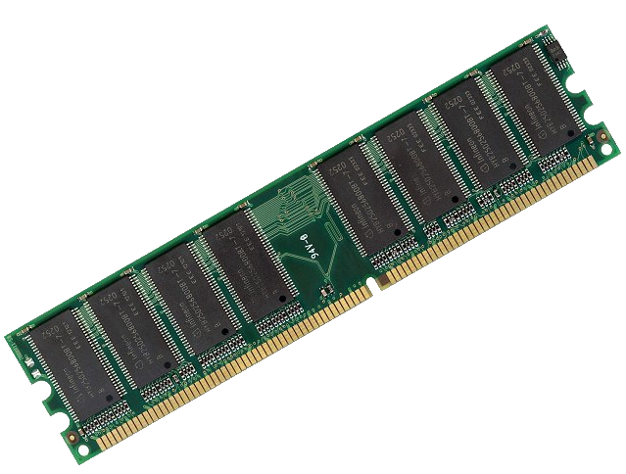
How Do We Map
Virtual Addresses to
Physical Addresses?
64-bit virtual address
space (16 exabytes)
FFFF’FFFF’FFFF’FFFF
Physical RAM
(e.g., 8 GB)
1’FFFF’FFFF
0’0000’0000
0000’0000’0000’0000
Notes:
An exabyte is a billion GBs!

Slide 4
Memory-mapping Units (MMUs)
MMU: A piece of hardware (only configurable by privileged code) that translates virtual addresses to physical addresses
  Virtual addresses are the addresses that executing code generates
  Physical addresses are what a processor presents to the actual RAM
//Code in address space
subq %rax, %rbx
addq %rcx, %rdx
movq 8(%r12), %r13
Physical
RAM
MMU
PhysAddr: 0xd089’5cb0
VirtAddr: 0000’4d0a’fc42’9280

Slide 5
Memory-mapping Units (MMUs)
MMU: A piece of hardware (only configurable by privileged code) that translates virtual addresses to physical addresses
  Virtual addresses are the addresses that executing code generates
  Physical addresses are what a processor presents to the actual RAM
//Code in address space
subq %rax, %rbx
addq %rcx, %rdx
movq 8(%r12), %r13
Physical
RAM
MMU
b (“byte”): one byte
w (“word”): two bytes
l (“long”): four bytes
q (“quad word”): eight bytes
PhysAddr: 0xd089’5cb0
VirtAddr: 0000’4d0a’fc42’9280

Slide 6
Memory-mapping Units (MMUs)
Using indirection via the MMU:
  A virtual address space can be larger than physical RAM (and vice versa)
  At any moment, some/none/all of a virtual address space can be mapped into physical RAM
  After a context switch to a new address space, we can lazily bring in the non-resident memory regions, as the address space’s code tries to access those regions
Virtual address
space 1
Physical RAM
Virtual address
space 2
Swap device

Slide 7
Memory-mapping Units (MMUs)
Using indirection via the MMU, we want to allow:
  Protection by default: the hardware maps the same virtual address in two different processes to different physical addresses
  Sharing when appropriate: a single region of physical RAM can map to multiple virtual address spaces (in possibly different locations!)
Virtual address
Virtual address
space 1
space 1
Physical RAM
Physical RAM
Virtual address
Virtual address
space 2
space 2

Slide 8
Outline
The structure of a virtual address space
Supporting virtual memory using paging
Fast translation using TLBs

Slide 9
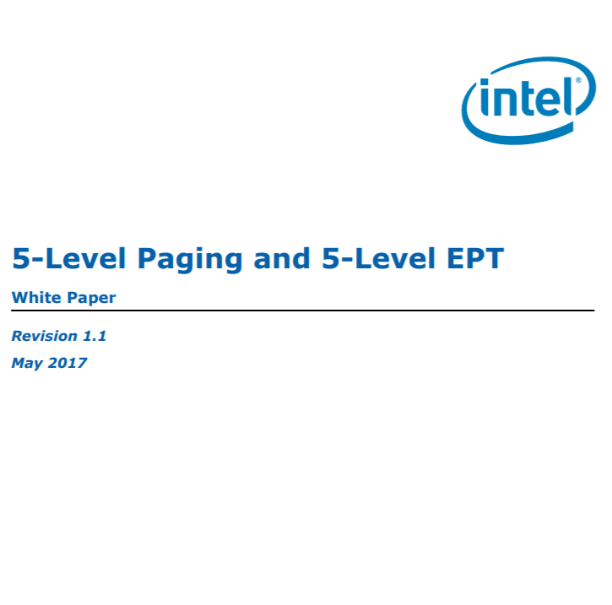
x86-64: Virtual Address Spaces
Current x86-64 chips only use 48 bits of an address
  Bits 48—63 must be copies of bit 47
  Kernel code+data lives in “high canonical” memory
  User code+data lives in “low canonical” memory
Intel is already thinking about how to extend addresses to 57 bits!
Virtual address space
FFFF’FFFF’FFFF’FFFF
Kernel static data
High canonical
(kernel-only access)
Kernel code
Kernel heap+stacks
FFFF’8000’0000’0000
Physical memory map
Empty gap
0000’7FFF’FFFF’FFFF
Stack
Low canonical
(kernel+user access)
Heap
Static data
0000’0000’0000’0000
Code
Notes:
Why does the diagram say “kernel stacks” plural? Well, the way that Chickadee (and Linux) works is that, when a new process is allocated, that process gets a user-mode stack and a kernel-mode stack. The kernel-mode stack is empty when the user-mode code is executing, but when the kernel needs to handle a syscall on behalf of the process, the kernel code uses the kernel-mode stack of the process. Does that make sense? [In Chickadee, a process’ kernel stack is the top half of the process’ struct proc; the struct proc is allocate an entire memory page, even though the members of the struct require much less space, so the remaining bytes in the page can be used for the kernel stack.]
[Lecturer note: As described by https://read.seas.harvard.edu/cs161-18/doc/memory-layout/, “Kernel code and global data is linked to use the highest 2GB of virtual addresses, 0xFFFF'FFFF'8000'0000–0xFFFF'FFFF'FFFF'FFFF. This range of kernel text addresses also corresponds to physical addresses by linear transformation: physical address P (0≤P≤0x7FFF'FFFF) maps to kernel text address 0xFFFF'FFFF'8000'0000+P . . . these choices mean that a Chickadee kernel could theoretically access up to 0x7FFF'8000'0000 bytes (262140GiB, or ~255TiB) of physical memory.“]
[Lecturer note: In case somebody asks, in Linux, the per-process stacks are not used to handle interrupts. Instead, Linux creates a special, per-CPU stack that is used to handle interrupts destined for that CPU. As described by [5], “Early in the 2.6 kernel series, an option was introduced to move to single-page kernel stacks, where each process is given only a single page (4KB on 32-bit architectures and 8KB on 64-bit architectures). This was done for two reasons:
It results in a page with less memory consumption per process.
As uptime increases, it becomes increasingly hard to find two physically contiguous unallocated pages. Physical memory becomes fragmented, and the resulting VM pressure from allocating a single new process is expensive.
There is one more complication. Each process’s entire call chain has to fit in its kernel stack. Historically, however, interrupt handlers also used the kernel stack of the process they interrupted, thus they too had to fit. This was efficient and simple, but it placed even tighter constraints on the already meager kernel stack. When the stack moved to only a single page, interrupt handlers no longer fit. To rectify this problem, the kernel developers implemented a new feature: interrupt stacks. Interrupt stacks provide a single per-processor stack used for interrupt handlers. With this option, interrupt handlers no longer share the kernel stack of the interrupted process. Instead, they use their own stacks. This consumes only a single page per processor.”
Chickadee also has per-CPU stacks, although they are used only briefly, at the beginning of interrupt/syscall dispatch, and when the kernel’s scheduling logic is switching between two tasks. See https://read.seas.harvard.edu/cs161-18/doc/contexts/, which says (among other things): “Chickadee can suspend kernel tasks. For instance, a Chickadee system call implementation can voluntarily or involuntarily give up control to another task, picking up later right where it left off. To make this work, each kernel task context has its own kernel stack. When the processor is running a kernel task, the %rsp register points into the corresponding stack. Just like any stack, a kernel task stack holds local variables. It also holds a snapshot of the task’s registers when the task is suspended . . . Kernel CPU contexts are used when switching from one kernel task to another. Each CPU has its own kernel CPU context; while kernel tasks can switch among CPUs, a CPU context is pinned to a single CPU. CPU contexts are not suspendable, and each CPU context has its own stack . . . Kernel stacks share memory pages with corresponding data structures. The bottom of the page of memory containing a CPU context stack holds a struct cpustate, and the bottom of the page of memory containing a kernel task stack holds a struct proc . . . When Chickadee’s exception handler gains control from a user-mode exception, it is executing on the kernel CPU-context stack. Its first job is to switch to the corresponding kernel task stack. This is important because all state associated with a process, including saved registers, should be stored in memory regions associated with that process, as opposed to the shared CPU-context stack . . . the [exception] handler pushes the rest of the general-purpose registers onto the stack and then callsproc::exception(regstate*).” So, in Chickadee, the CPU stacks are sparingly used: at the beginning of exception/syscall handling (before the kernel has switched to the appropriate kernel task) and in-between the execution of two kernel tasks (because the scheduler uses the CPU stack while switching between two tasks---see k-exception.S’s yield and resume code, plus k-cpu.cc::schedule()]
[Lecturer note: The kernel memory region has a lot of stuff in it; see Ref [2] for more details.]
[Refs: [1] https://en.wikipedia.org/wiki/X86-64#Virtual_address_space_details
[2] https://www.kernel.org/doc/Documentation/x86/x86_64/mm.txt
[3] https://www.kernel.org/doc/Documentation/x86/kernel-stacks
[4] https://jasoncc.github.io/kernel/jasonc-mm-x86.html
[5] https://notes.shichao.io/lkd/ch12/]

Slide 10
x86-64: Virtual Address Spaces
Each process gets its own address space
  The kernel is mapped into the same place in each address space
  Content in low canonical memory is mostly unique (i.e., per-process)
Why can’t user-level code tamper with kernel state?
  The CPU has a privilege bit: indicates whether currently-executing code is kernel code
  MMU prevents unprivileged code from touching privileged memory
  Privilege bit flips during system calls, interrupts, and exceptions
Virtual address space
FFFF’FFFF’FFFF’FFFF
void main(){
int x = 42;
void* ptr = malloc(64);
printf(“&x: %p\n”, (void*)&x); //0x0000’7ffd’754e’adbc
printf(“&ptr: %p\n”, (void*)&ptr); //0x0000’7ffd’754e’adc0
printf(“ptr: %p\n”, (void*)ptr); //0x0000’5557’e367’d260
printf(“main: %p\n”, (void*)main); //0x0000’5557’e2b8’3155
}
Kernel static data
High canonical
(kernel-only access)
Kernel code
Kernel heap+stacks
FFFF’8000’0000’0000
Physical memory map
Empty gap
0000’7FFF’FFFF’FFFF
Stack
Low canonical
(kernel+user access)
Heap
Static data
0000’0000’0000’0000
Code
Notes:
Why is the content in the bottom half of an address space only “mostly” unique? Here’s one example: suppose that you launch two different instances of a web server, so that you have two separate processes. Each process will have the same contents in its code region. However, the stacks and the heaps will be different, because each process has its own set of dynamic state that is created in response to client requests.

Slide 11
x86-64: Virtual Address Spaces
Typically much smaller than the virtual address space!
Virtual address space
FFFF’FFFF’FFFF’FFFF
Kernel static data
Physical RAM
High canonical
(kernel-only access)
Kernel code
MAX_PHYS
Kernel heap+stacks
FFFF’8000’0000’0000
Physical memory map
Empty gap
0000’7FFF’FFFF’FFFF
Stack
Low canonical
(kernel+user access)
0
Heap
Direct linear translation:
Physical address P ↔ 0xFFFF'8000'0000'0000+P
Static data
0000’0000’0000’0000
Code
High canonical address

Slide 12
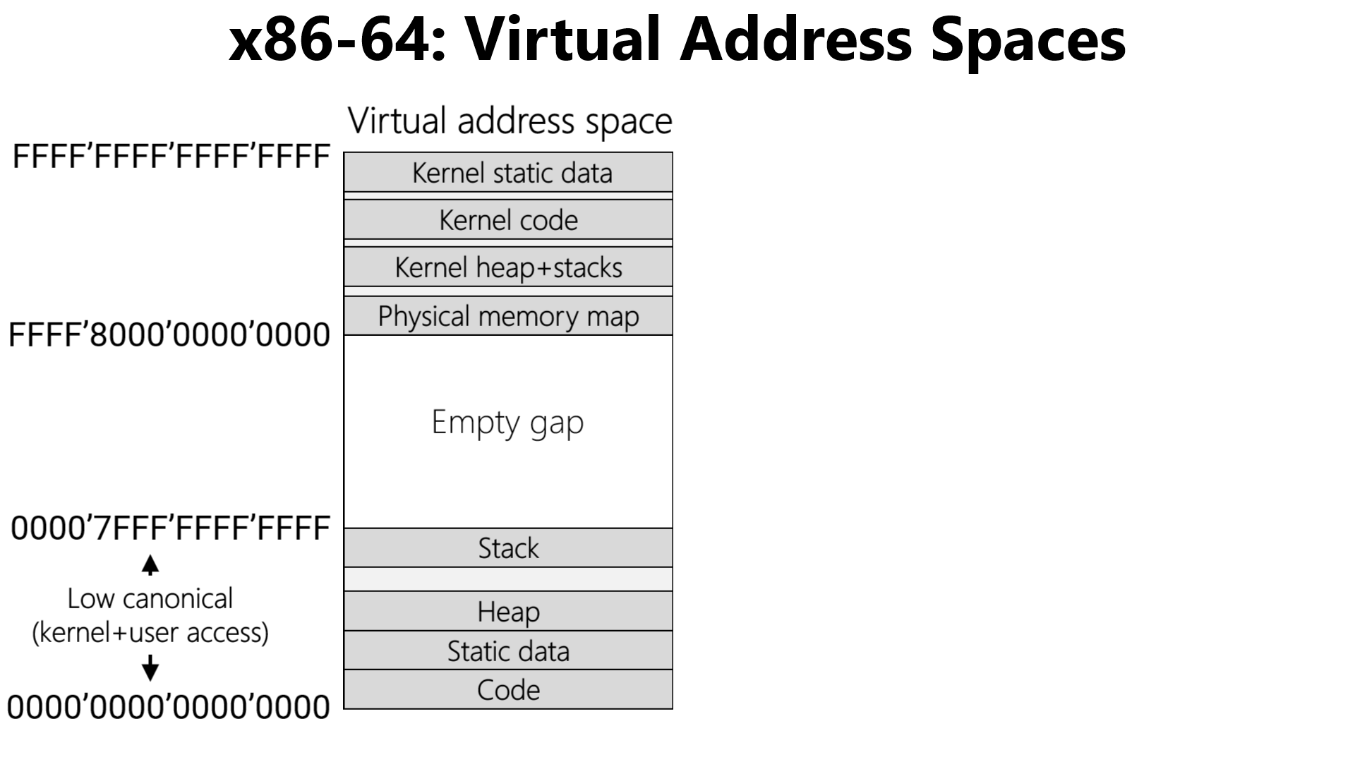
Typically much smaller than the virtual address space!
Highest 2GB
Physical RAM
MAX_PHYS
0x7FFF'FFFF
Lowest 2GB
0
Direct linear translation:
Physical address P (0≤P≤0x7FFF'FFFF) ↔
0xFFFF'FFFF'8000'0000+P
Notes:
The code and static data of the kernel are often collectively refered to as the “kernel text.”

Slide 13
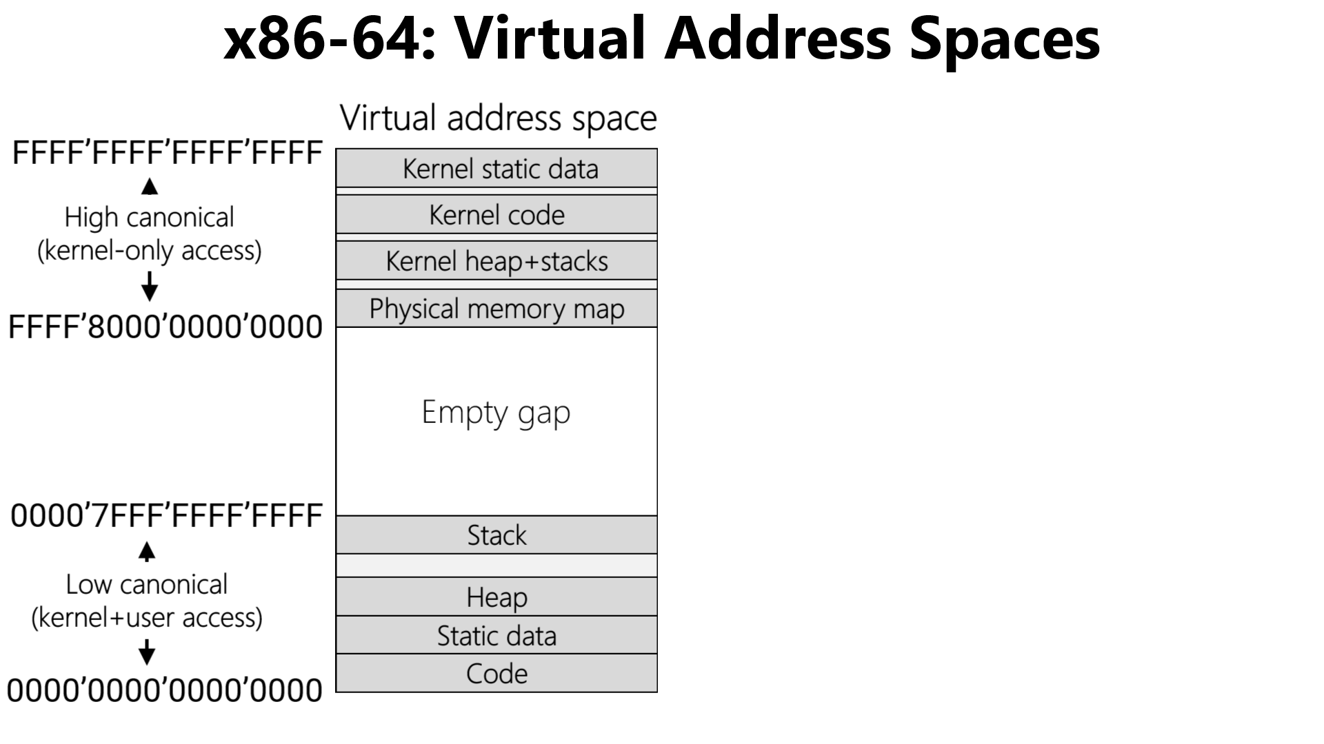
Typically much smaller than the virtual address space!
Physical RAM
MAX_PHYS
Wherever kernel text actually stops
Kernel text
0
No simple correspondence between user-mode virtual addresses and the underlying physical addresses: the miracle of paging!
Notes:
Note that the actual size of the kernel text will typically be less than 2 GB in practice. In other words, it’s unlikely that an OS will have 2 GB of code and static data. So, in practice, the user-related content (e.g., like user-mode stacks) may be mapped into physical region beneath the 2GB barrier.

Slide 14
Outline
The structure of a virtual address space
Supporting virtual memory using paging
Fast translation using TLBs

Slide 15
Paging
Virtual address
Divide virtual address space and the physical RAM into fixed-sized chunks called pages
Make each page small (e.g., 4 KB)
  Good: Can allocate virtual address space with fine granularity
  Good: Only need to bring the specific pages that process needs into physical RAM
  Possibly concerning: Bookkeeping overhead—a single address space contains many pages!
Virtual Page Number
Offset
Virtual address
space of 2^V pages
Physical RAM
V bits
O bits
with 2^P pages
X
MMU
Y
Y
P bits
Not present in RAM
(e.g., swapped to disk)
Physical Page Number
Offset
Z
MMU
Z
X
Physical address
Notes:
Why would a virtual page be swapped to disk? Well, there may be a lot of processes that are running; if so, that means that a lot of processes will want to put their virtual pages in RAM. If all of the pages can’t fit at once, then some of those pages need to be stored on disk, where they can be retrieved later.
Note that a virtual page may also be absent in RAM for another reason---the associated process hasn’t allocated that page. For example, the heap grows when a program calls malloc() or new. When a process initially starts, the process hasn’t allocated any heap memory, so the associated parts of the virtual address space are not associated with actual virtual pages.

Slide 16
Case study: x86-64
L4
L3
L2
L1
Offset
47
39
38
30
29
21
20
12
11
0
Holds the physical address of a 4 KB-aligned PML4
Highest-order bits not useful for address translations!
%cr3

Slide 17
Case study: x86-64
L4
L3
L2
L1
Offset
47
39
38
30
29
21
20
12
11
0
A 4 KB-aligned PDP has 512 8-byte entries
A 4 KB-aligned PML4 has 512 8-byte entries
%cr3
9 bits
Bookkeeping stuff
PDPTE
9 bits
Page directory pointer
PML4E
PML4E
4KB-aligned PDPTE physAddr
64 bits
Page map level 4
63
48
47
12
11
0

Slide 18
Case study: x86-64
L4
L3
L2
L1
Offset
47
39
38
30
29
21
20
12
11
0
A 4 KB-aligned PDP has 512 8-byte entries
9 bits
PDE
%cr3
9 bits
Page directory
Bookkeeping stuff
PDPTE
9 bits
Page directory pointer
A 4 KB-aligned PD has 512 8-byte entries
PML4E
PDPTE
4KB-aligned PDE physAddr
64 bits
Page map level 4
63
48
47
12
11
0

Slide 19
Case study: x86-64
L4
L3
L2
L1
Offset
47
39
38
30
29
21
20
12
11
0
9 bits
PDE
%cr3
9 bits
Page directory
Bookkeeping stuff
PDPTE
9 bits
Page directory pointer
A 4 KB-aligned PD has 512 8-byte entries
PML4E
PDE
4KB-aligned PTE physAddr
64 bits
Page map level 4
63
48
47
12
11
0

Slide 20
Case study: x86-64
L4
L3
L2
L1
Offset
47
39
38
30
29
21
20
12
11
0
PhysAddr
12 bits
4KB page
9 bits
PTE
9 bits
Page table
PDE
User-mode accessible?
%cr3
Writeable?
9 bits
Page directory
A 4 KB-aligned PT has 512 8-byte entries
PDPTE
Present?
9 bits
Page directory pointer
PML4E
PTE
4KB-aligned physFrame addr
64 bits
Page map level 4
63
48
47
12
11
3
2
1
0

Slide 21

Why so many levels?
Virtual address spaces are sparse!
  Ex: Most processes don’t have gigabytes of code
  Ex: Most processes don’t have gigabytes of stack frames
Multi-level tables: only materialize entries for live parts of address space
  Ex: A single PML4E covers 512 GB
  If none of those addresses are in use, just set the PML4E.present bit to 0!
  Don’t need to create PDP/PD/PT tables for the subtree
User-mode accessible?
Writeable?
Bookkeeping stuff
Present?
Bookkeeping stuff
PML4E
PML4E
4KB-aligned PDPTE physAddr
4KB-aligned PDPTE physAddr
63
48
47
63
48
47
12
11
12
11
3
1
0
2
0

Slide 22
Chickadee: Initializing Page Tables During Boot
//x86-64.h
typedef uint64_t x86_64_pageentry_t;
typedef struct x86_64_pagetable {
x86_64_pageentry_t entry[1 << PAGEINDEXBITS];
} x86_64_pagetable;
//k-init.cc
x86_64_pagetable early_pagetable[3];
void init_early_memory() {
//...some code...
// initialize early page table
memset(early_pagetable, 0, sizeof(early_pagetable));
// level-4 page table:
// - entry 0 maps first 512GiB of low canonical addresses
// - entry 256 maps first 512GiB of high canonical addresses
// - entry 511 maps last 2GiB of high canonical addresses (kernel text)
early_pagetable->entry[0] = ktext2pa(&early_pagetable[1]) | PTE_P |
PTE_W;
early_pagetable->entry[256] = early_pagetable->entry[0];
early_pagetable->entry[511] = ktext2pa(&early_pagetable[2]) | PTE_P |
PTE_W;
// first level-3 page table maps first 512GiB of physical memory
// (low canonical and high canonical)
for (uintptr_t p = 0; p < 512; ++p) {
early_pagetable[1].entry[p] = (p << 30) | PTE_P | PTE_W | PTE_PS;
}
// second level-3 page table maps its last 2 slots to the first 2GiB
// of physical memory (kernel text)
early_pagetable[2].entry[510] = early_pagetable[1].entry[0];
early_pagetable[2].entry[511] = early_pagetable[1].entry[1];
wrcr3(ktext2pa(early_pagetable));

Slide 23
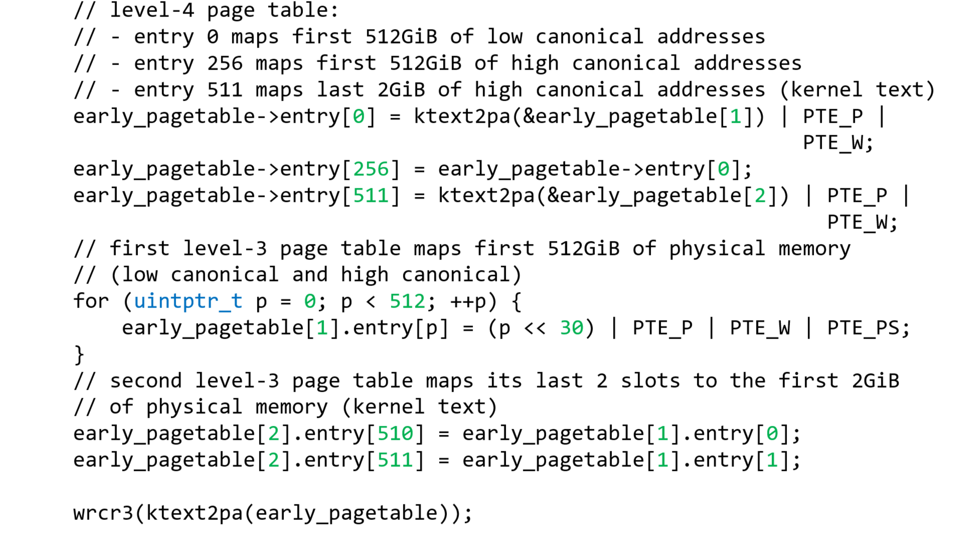
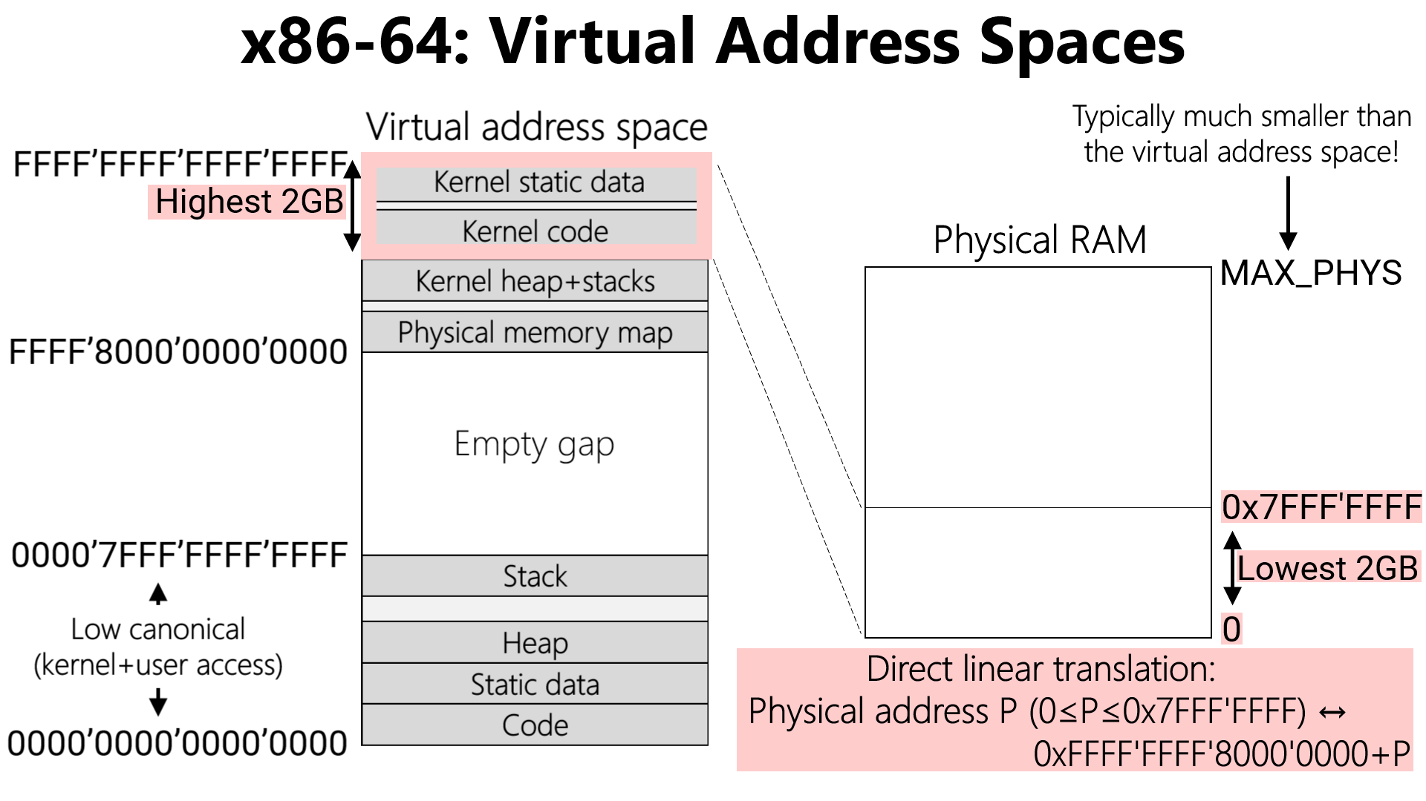
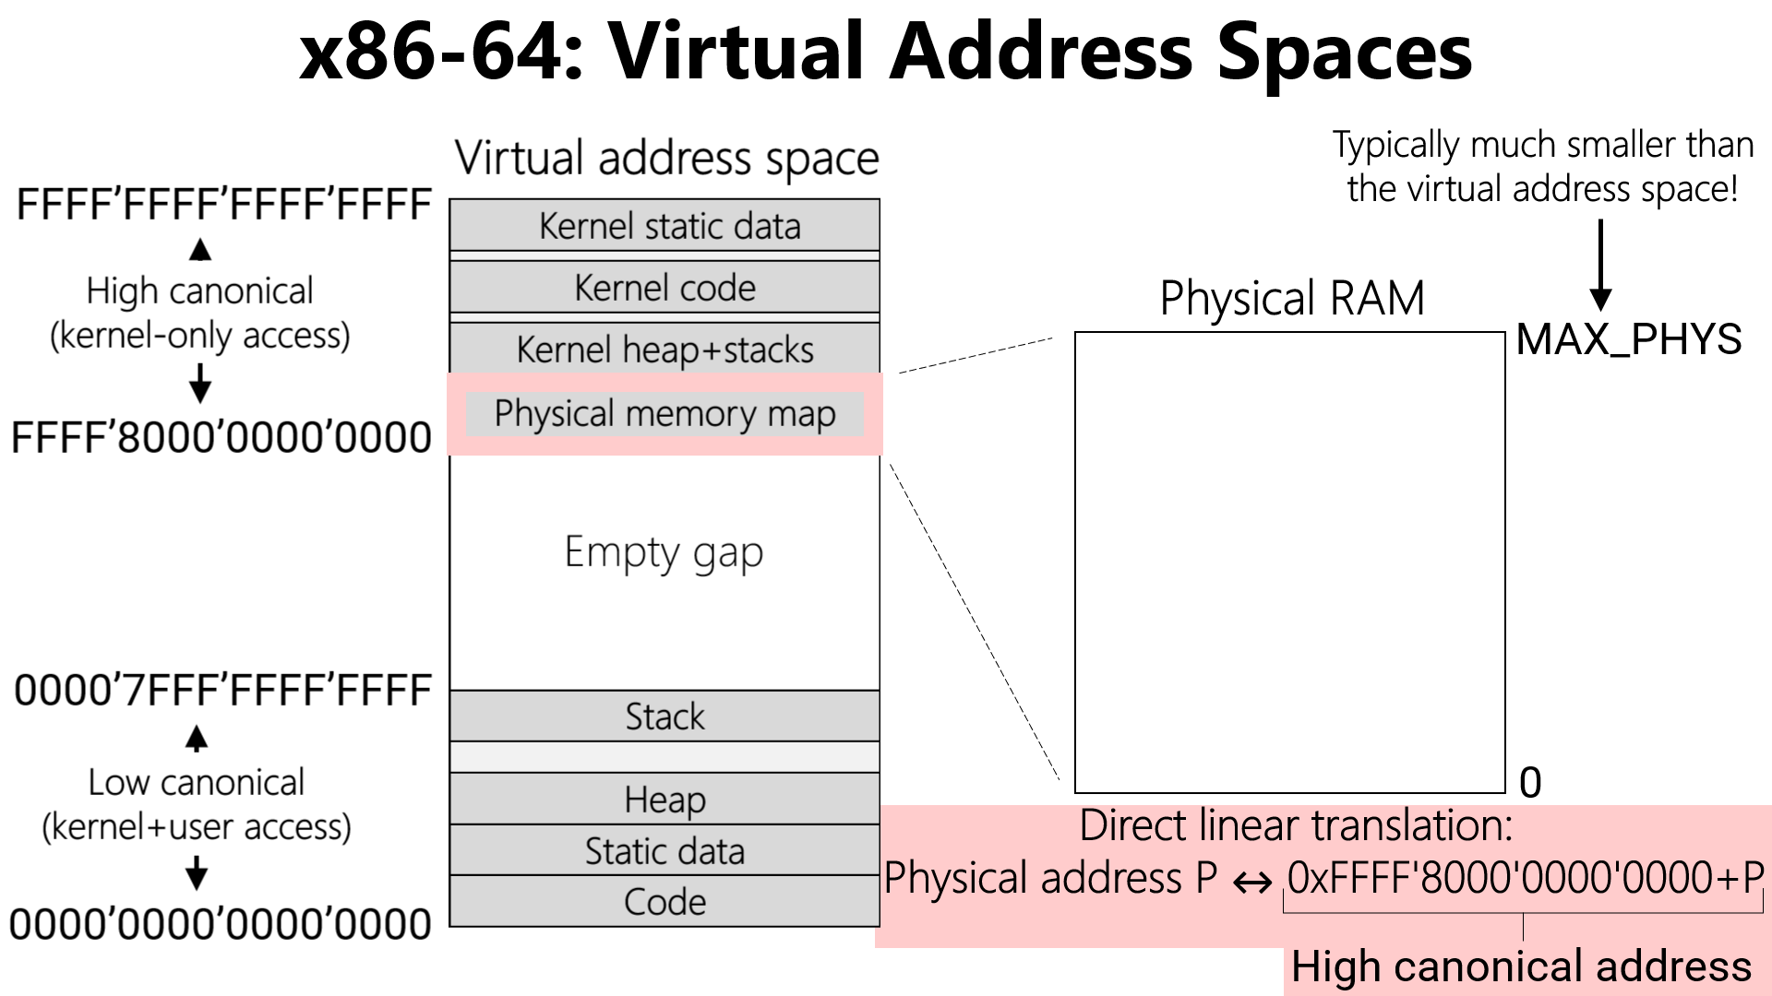

Slide 24
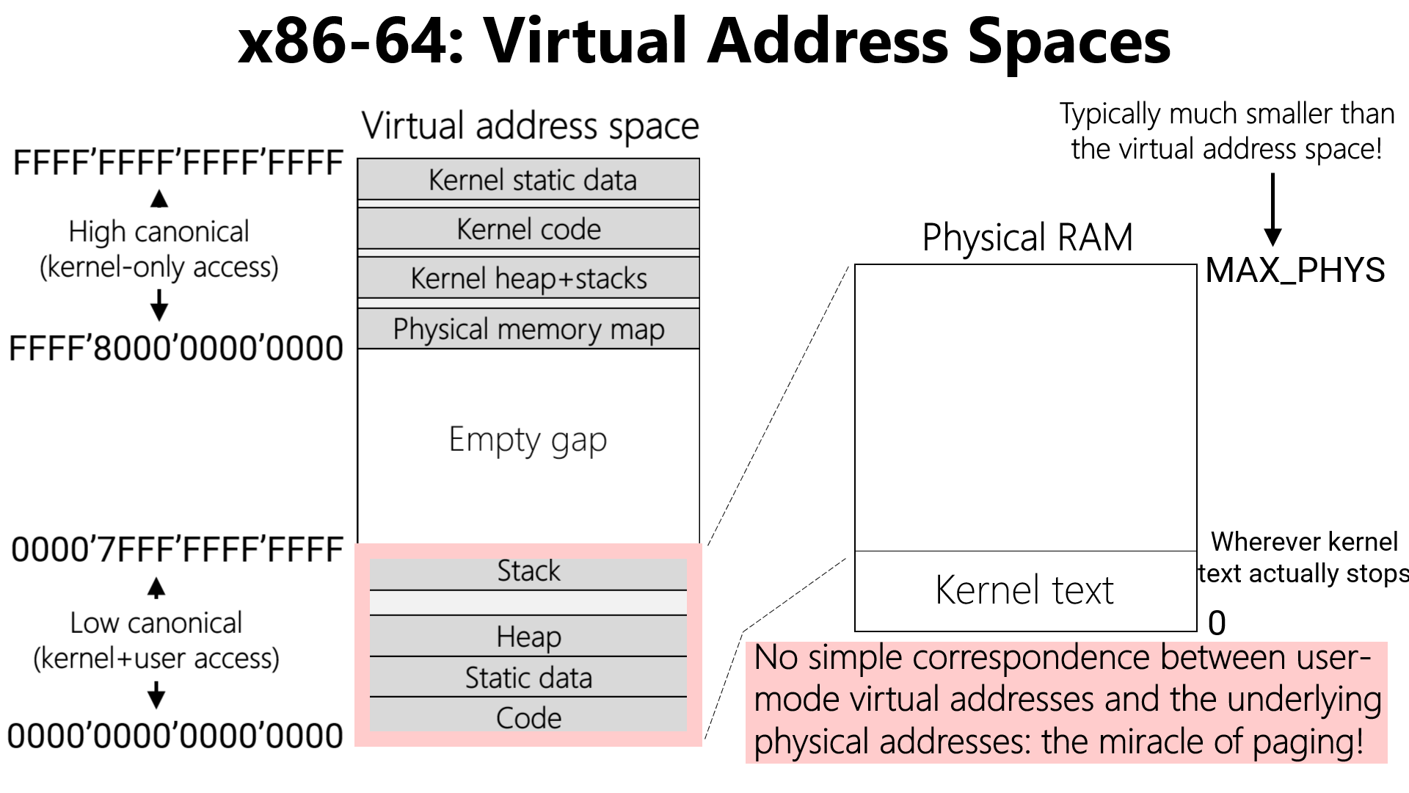
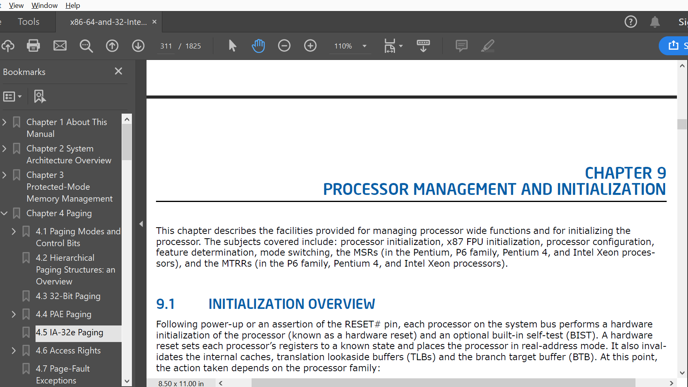



Chickadee: Page Tables
During boot, Chickadee creates a physical memory map in high canonical addresses *and* low canonical addresses
However, post-boot, low-canonical addresses are for user-mode content, not a memory map!
  The boot-time kernel only needs the low-canonical memory map to assist with x86 configuration horrors
  For example, one challenge is that, when an x86 processor powers on, it can only access 64 KB of physical RAM
  At a more detailed level, I DON’T WANT TO TALK ABOUT IT

Slide 25
Outline
The structure of a virtual address space
Supporting virtual memory using paging
Fast translation using TLBs

Slide 26
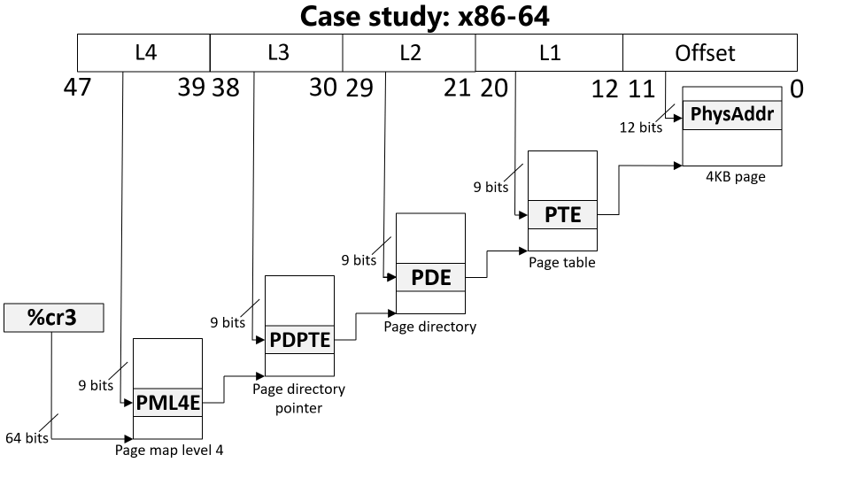
Paging: The Good and the Bad
Good: A virtual address space can be bigger/smaller than physical memory
Bad: Each virtual memory access now requires five physical memory accesses
x86-64 physical memory accesses
Load entry from page map level 4
Load entry from page directory pointer
Load entry from page directory
Load entry from page table
Generate the “real” memory access

Slide 27

Translation Lookaside Buffers (TLBs)
Idea: Cache some PTEs (i.e., V->P translations) in a small hardware buffer
  If virtual address has an entry in TLB, don’t need to go to physical memory to fetch PTEs!
  If virtual address misses in TLB, we must suffer physical memory accesses to fetch PTE
Key/value store: key is high bits of virt addr, value is phys frame number
TLB
TLB
L1 i-cache
L1 d-cache
L1 i-cache
L1 d-cache
L2 cache
L2 cache
L3 cache
RAM

Slide 28
Translation Lookaside Buffers (TLBs)
Idea: Cache some PTEs (i.e., V->P translations) in a small hardware buffer
  If virtual address has an entry in TLB, don’t need to go to physical memory to fetch PTEs!
  If virtual address misses in TLB, we must pay at least one physical memory access to fetch PTE
TLBs are effective because programs exhibit locality
  Temporal locality
    When a process accesses virtual address x, it will likely access x again in the future
    Ex: a function’s local variable that lives on the stack
  Spatial locality
    When the process accesses something at memory location x, the process will likely access other memory locations close to x
    Ex: reading elements from an array on the heap
Notes:
Temporal locality means that a TLB entry that has recently been accessed will be accessed again in the near future.
Spatial locality means that, when we access a virtual address x, and we create a TLB entry for the associated page, the TLB entry will likely be useful for other virtual addresses that the program accesses. Remember that a TLB entry covers an entire page of spatially contiguous addresses! For machines that have a lot of physical RAM, you might want a single TLB entry to cover a much larger region than 4 KB. x64 supports this idea using “superpages.” When a process’s page table uses superpages, each PTE and TLB entry covers 2 MB or 1 GB instead of 4 KB. [For reference on superpages, see Section 4.5 (“IA-32E Paging”) of “Intel® 64 and IA-32 Architectures Software Developer’s Manual Volume 3 (3A, 3B, 3C & 3D): System Programming Guide.”]

Slide 29
The Lifecycle of a Memory Reference on x86
Virtual address
TLB lookup
No
Yes
TLB hit?
HW walks the page table
Check protection bits
No
Yes
Yes
No
Access ok?
Found PTE for virt frame?
HW updates TLB
HW raises a page fault
HW raises a page fault
Calculate phys addr, send to L1/L2/L3/RAM
Notes:
Note that the protection bits state things like “is this page writable?” and “is this page accessible to user-mode processes?”

Slide 30
The Lifecycle of a Memory Reference on x86
Virtual address
Before raising page fault exception, HW sets %cr2 to faulting address, and pushes an error code onto stack
TLB lookup
-Ex: User process tried to read a nnon-present page
-Ex: User process tried to write aa present but read-only page
No
Yes
TLB hit?
HW walks the page table
Check protection bits
No
Yes
Yes
No
Access ok?
Found PTE for virt frame?
HW updates TLB
HW raises a page fault
HW raises a page fault
Calculate phys addr, send to L1/L2/L3/RAM

Slide 31







Context Switches:
Which TLB mappings have to be invalidated?
Scheduler queue:
Scheduler queue:
Core 0
Core 1
TLB
TLB
L1 i-cache
L1 d-cache
L1 i-cache
L1 d-cache
TLB mappings for
L2 cache
L2 cache
TLB mappings for
web browser
shell
L3 cache
RAM

Slide 32
TLBs and Context Switches
If each TLB entry can be tagged with a process context id (PCID):
  OS updates the active PCID during a context switch
  No need to flush any TLB entries during a context switch!
    Even if some entries must be evicted as the new process executes, this is better than having to evict ALL entries during EVERY context switch (since this requires |TLB| page table walks when a new process starts to warm TLB)
    Scheduler can reduce invalidations with address-space-to-core affinity
  Ex: x86-64 supports up to 4096 PCIDs
If TLB entries are *not* tagged with PCIDs, then all TLB entries must be invalidated during a context switch
  Ex: On x86-32, the lack of PCID support means that writing to %cr3 invalidates all TLB entries
Notes:
[Additional details for the curious: RISC architectures typically use the term “address space identifier (ASID)” instead of the x86-preferred term “process context identifier (PCID).” Also note that the x86 PCID mechanism only support a maximum of 4096 ids. So, Linux keeps a per-CPU PCID pool, and rotates the identifiers in a pool among the processes that run on the associated CPU.]

