Slide 1

Buddy Allocation
CS 161: Lecture 5
2/11/19

Slide 2
Allocating memory in the kernel
Kernels often need to dynamically allocate memory
  Ex: Creating a new address space during fork()
    Page table
    struct proc
    Copies of user-mode pages from the parent process
Physical RAM
Child code+heap+stack pages
Parent code+heap+stack pages
Child page table entries
for low canonical addresses
Parent page table entries
for low canonical addresses
Child struct proc
Parent struct proc
Kernel text (includes page table entries for high canonical addresses + kernel text)

Slide 3
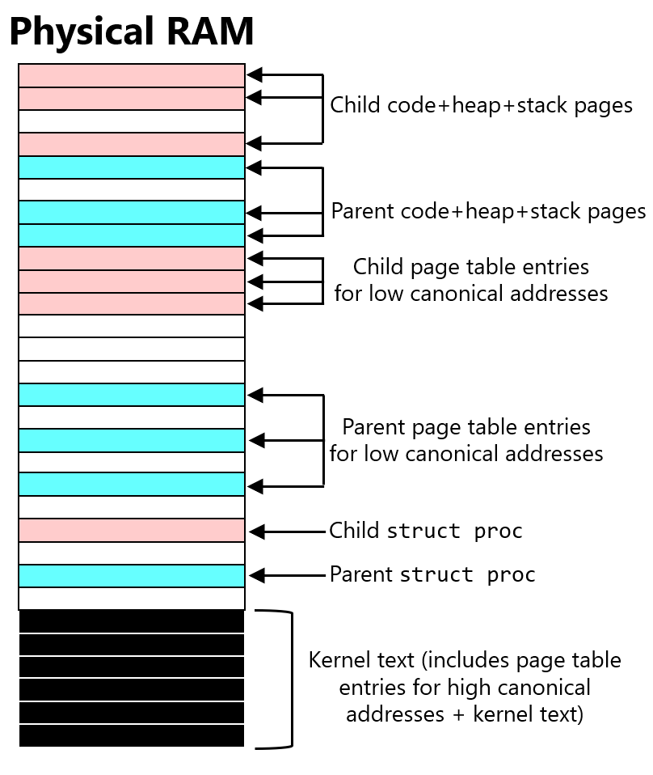

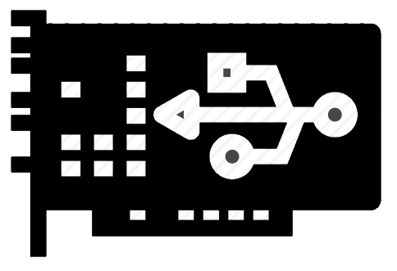
Allocating memory in the kernel
Kernels often need to dynamically allocate memory
  Ex: Creating a new address space during fork()
    Page table
    struct proc
    Copies of user-mode pages from the parent process
  Ex: Allocating buffers to hold incoming IO data
    IO devices often unaware of virtual addressing
    Consequently:
      Kernel must specify a physical start address for a device-to-RAM transfer
      If destination memory buffer is multiple pages in size, those pages must be contiguous in physical memory!
Network card

Slide 4
Allocating memory in the kernel
Kernels often need to dynamically allocate memory
  Ex: Creating a new address space during fork()
    Page table
    struct proc
    Copies of user-mode pages from the parent process
  Ex: Allocating buffers to hold incoming IO data
  Ex: Growing the user-level heap via the sbrk(size_t increment) syscall (which is internally invoked by malloc())
Many (but not all) kernel allocations have a page-sized granularity
Virtual address space
(low canonical)
Stack
Linux stacks
Automatically grown by kernel after a page fault . . .
. . . but only up to a limit (e.g., 8MB; run ulimit –s)
Heap
Static data
Code
Notes:
[A Linux process can also add pages to the virtual address space via mmap(). Chickadee’s SYS_PAGE_ALLOC is roughly analogous, inasmuch as it allows a process to map a new page into the virtual address space.]
[What about the stack—does it automatically grow if, e.g., user-space code makes a lot of nested function calls? It could; the OS could choose to detect page faults to region immediately beneath the current top of stack, and automatically allocate a new page. Linux does this. However, Linux also limits the maximum size of each thread’s stack to a fixed amount like 8 MB. On Linux, the command ‘ulimit –s’ will show the default stack size; a sysadmin can also use ulimit to change the default.]
[Chickadee stacks do not grow on a page fault. Also note that the p-allocator.cc program maintains a variable called heap_top that is like the brk pointer that a Linux malloc implementation would track.]

Slide 5

x86-64 Linux: void *kmalloc(size_t size,…)
Returns a chunk of memory that is both virtually-contiguous and physically-contiguous
  Returned virtual address resides in the physical memory map that uses direct mapping of virtual-to-physical addresses
  So, kmalloc() doesn’t need to manipulate page tables to satisfy a request!
Uses slab allocation
  Maintains several memory pools
  Each pool satisfies requests for a certain size (e.g., 64 bytes, 1 MB)
  Requests satisfied by smallest possible slab
Virtual address space
(high canonical)
Kernel text
(direct-mapped to
bottom of physical RAM)
pset2.a is basically Linux kmalloc() without slab allocation
Direct map of all physical RAM

Slide 6
x86-64 Linux: void *vmalloc(unsigned long size)
Returns a chunk of memory that is virtually-contiguous, but possibly not physically-contiguous
Allocates objects at a page-size granularity
Internally, vmalloc() repeatedly:
  Finds a free physical page
  Modifies page table entries to map the physical page into the next contiguous virtual page
Disadvantage: Page table modifications take time
Advantage: More likely to succeed than kmalloc() if memory pressure is high
Chickadee has no equivalent of vmalloc()
Virtual address space
(high canonical)
Kernel text
(direct-mapped to
bottom of physical RAM)
Physical RAM
vmalloc() area (uses arbitrary mappings)
Direct map of all physical RAM
Notes:
[A second disadvantage of vmalloc() is that, since the allocated physical pages are not contiguous, they may not be able to be covered by a small number of “huge” TLB mappings (i.e., TLB mapping that cover more than a 4 KB page—either 2 MB or 1 GB).]
[Note that memory returned by kmalloc() should be released by kfree(); similarly, memory returned by vmalloc() should be released using vfree().]
[Reference: https://www.kernel.org/doc/Documentation/x86/x86_64/mm.txt
//Shows that the virtual address region used by
//vmalloc() is different than the one used by the
//physical memory map.]

Slide 7
Buddy allocation
Memory is allocated in units of 2º bytes
  A request of size s bytes receives a block of 2º bytes, where o = ⌈log₂s⌉
  Allocator has a min order and a max order (e.g., 12 and 21)
Allocation splits large free blocks until one of size o is created
Freeing combines buddies to create large blocks

Slide 8
Buddy allocation
Memory is allocated in units of 2º bytes
  A request of size s bytes receives a block of 2º bytes, where o = ⌈log₂s⌉
  Allocator has a min order and a max order (e.g., 12 and 21)
def allocate(o):
while True:
if isFreeBlockOfOrder(o):
return getFreeBlockOfOrder(o)
else:
block, x = getSmallestFreeBlock() #x > o
if block != None:
splitIntoBuddies(block) #Buddies of order x-1
continue #Hopefully isFreeBlockOfOrder(o) is
#now True
else:
return None

Slide 9
Buddy allocation
Memory is allocated in units of 2º bytes
  A request of size s bytes receives a block of 2º bytes, where o = ⌈log₂s⌉
  Allocator has a min order and a max order (e.g., 12 and 21)
def free(freedBlock, o):
freedBlock.free = True
while freedBlock.buddyOfOrder(o).free:
freedBlock = coalesce(freedBlock,
freedBlock.buddyOfOrder(o))
o += 1
freedBlock.free = True

Slide 10
A=83KB
1024 KB
512 KB
512 KB
256 KB
256 KB
512 KB
128 KB
128 KB
256 KB
512 KB
B=37KB
128 KB
128 KB
256 KB
512 KB
128 KB
64KB
64KB
256 KB
512 KB
C=79KB
128 KB
64KB
64KB
256 KB
512 KB
128 KB
64KB
64KB
128 KB
128 KB
512 KB

Slide 11
128 KB
64KB
64KB
128 KB
128 KB
512 KB
free(A)
128 KB
64KB
64KB
128 KB
128 KB
512 KB
D=63KB
128 KB
64KB
64KB
128 KB
128 KB
512 KB
free(B)
128 KB
64KB
64KB
128 KB
128 KB
512 KB
free(D)
128 KB
64KB
64KB
128 KB
128 KB
512 KB
128 KB
128 KB
128 KB
128 KB
512 KB
256 KB
128 KB
128 KB
512 KB

Slide 12
256 KB
128 KB
128 KB
512 KB
free(C)
256 KB
128 KB
128 KB
512 KB
256 KB
256 KB
512 KB
512 KB
512 KB
1024 KB

