Slide 1
Wait queues
CS 161: Lecture 7
2/20/19

Slide 2
Implementing sleep(ms) Inefficiently
//kernel.hh
#define HZ 100 // number of ticks per second
//kernel.cc
volatile unsigned long ticks; // # timer interrupts
// so far on CPU 0;
// incremented when
// timer interrupt
// fires
Will overflow if machine runs for a long time!
Notes:
[We make the ticks variable “volatile” because it’s accessed by multiple cores, so we don’t want the compiler to cache the value in a register on some CPU, such that other CPUs read the value from memory and see the wrong ticks count.]
[The +9 part ensure that we sleep for at least one timer interrupt period if a positive ms argument is used. For example, if the caller specifies a sleep duration of 1 ms, then the kernel will sleep for (1+9)/10=1 timer interrupt period; since HZ = 100, one timer interrupt period is 10 ms. If the caller specifies a sleep duration of 9 ms, then the kernel will sleep for (9+9)/10 = 1 timer interrupt period; remember that in C, integer division uses truncation towards 0. [Ref: https://stackoverflow.com/a/3602857]]

Slide 3
Implementing sleep(ms) Inefficiently
//kernel.cc
switch(regs->reg_rax) {
case SYSCALL_MSLEEP: {
unsigned long wakeup_time = ticks +
(regs->reg_rdi + 9) / 10;
while (long(wakeup_time - ticks) > 0) {
this->yield();
}
return 0;
}
//...Other syscalls...
User-mode part of process goes to sleep, but . . .
. . . kernel-half stays runnable, repeatedly testing the exit condition and then yielding! Polling is gross.
Like want_ticks > ticks, but works even if ticks overflows!
Notes:
The trick works as long as (1) the computer uses two’s complement to represent numbers, (2) the subtraction of two unsigned longs wraps around, and (3) the difference between the two is in the range of an unsigned long. Note that hardware ensures (1), and the C++ standard guarantees (2).
For example:
a = 0101 b = 0110
0101
1001
+ 1
-----
1111 = 15 unsigned = -1 signed
Remember that in two’s complement, a leading bit of 1 means the number is negative, and a leading bit of 0 means that the number is positive. For a negative number, the magnitude is determined by flipping all of the bits and then adding 1. This is why 1111 in binary is -1 signed decimal.
[Ref: https://stackoverflow.com/questions/2061245/how-to-subtract-two-unsigned-ints-with-wrap-around-or-overflow
https://en.wikipedia.org/wiki/Signed_number_representations#History
https://www.cs.cornell.edu/~tomf/notes/cps104/twoscomp.html]

Slide 4
The Challenges of Blocking
Kernel tasks often need to block until an event occurs
Ex: A certain amount of time has elapsed (as in sleep(ms))
Ex: Keyboard data arrives
Ex: A (non-spinlock) lock is released
How can the kernel create an efficient mechanism to handle arbitrary types of blocking events?
Notes:
[Note: A spinlock doesn’t have a queue because acquiring a spin lock “blocks” by just repeatedly testing the lock condition!]

Slide 5
Wait Queues to the Rescue!
Have a queue for each type of blocking event
Threads that wait for the same event will sleep on the same queue
When the event is noticed by a running kernel thread, that thread will wake the sleepers in the relevant queue
Correctly implementing the wait queue is tricky!
True blocking is
now possible!

Slide 6
The Lifecycle of a Process
Running
Runnable
Finished
Parent process
calls fork()
Blocked

Slide 7
The Lifecycle of a Process
Scheduler
Running
Runnable
Finished
Scheduler
Parent process
calls fork()
Blocked
Scheduler
Scheduler Algorithms
Ready queue
FIFO?
Priorities?

Slide 8
The Lifecycle of a Process
Scheduler
Running
OS can use:
More than one queue (e.g., one per lO device)
Fancier data structures than queues (e.g., timing wheel to implement sleep(ms))
IO wanted
Runnable
sleep(ms)
Finished
Scheduler
IO completes
Synchronization
(e.g., lock acquisition)
Sleep period ends
Blocked
Synchronization
completes
Scheduler
Ready queue
Blocked queue

Slide 9
The Lifecycle of a Process
Scheduler
Running
exit()
IO wanted
Runnable
sleep(ms)
Finished
Scheduler
IO completes
Synchronization
(e.g., lock acquisition)
Sleep period ends
Blocked
Synchronization
completes
Scheduler
Ready queue
Blocked queue
Notes:
The final process state that we’ll examine is the “finished” state. A process can explicitly terminate itself by calling the exit() function. Note that, if a program reaches the “return” statement at the end of main(), the return statement will eventually end up calling exit().
[By the way, a zombie process is one that has exit()ed, but whose parent hasn’t called wait(). An orphan process is one that is still executing, but whose parent has died. All orphan processes are reparented so that init is their parent; init basically sits in a loop, repeatedly calling wait().]

Slide 10
Formalizing the Blocking Problem
Let x be a subset of program state
A sleeping thread blocks until f(x) is true
A waking thread modifies x in a way that cause f(x) to become true
Sounds trivial, right?
COMPLETELY AND UTTERLY FALSE
YOU MORTAL FOOLS

Slide 11
Sleep/wakeup: Attempt #1
Sleeper thread
Wakeup thread

Slide 12
Computes f(x) == false
Decides to block
Modifies x so that f(x) is true
Looks for sleeping threads, finds none
Does other stuff
Blocks forever, unbounded suffering occurs
Maybe locks can help us avoid bad interleavings?

Slide 13
Sleep/wakeup: Attempt #2
x_lock.lock()
Computes f(x) == false
Decides to block
Tries to x_lock.lock() and blocks
Blocks forever (holding x_lock), society degenerates into chaos

Slide 14
Sleep/wakeup: Attempt #3
x_lock.lock()
Computes f(x) == false
Decides to block
x_lock.unlock()
x_lock.lock()
Does stuff so f(x) is true
Finds no sleeping threads
x_lock.unlock()
Blocks forever, all teddy bears are destroyed
Problem: Lost wakeups
Cause: Releasing the lock and blocking aren’t atomic!

Slide 15
Sleep/wakeup: Solution #1
x_lock.lock()
Computes f(x) == false
Decides to block
cond_wait(&x_cond, &x_lock)
x_lock.lock()
Does stuff so f(x) is true
cond_signal(&x_cond) wakes up sleeping thread
x_lock.unlock()
Atomically releases lock
and blocks thread; when it
returns, lock held by caller
What if the wakeup thread runs first?

Slide 16
Sleep/wakeup: Solution #1
x_lock.lock()
Computes f(x) == false
Decides to block
cond_wait(&x_cond, &x_lock)
with no threads to wake
x_lock.lock()
Does stuff so f(x) is true
cond_signal(&x_cond) wakes up sleeping thread
x_lock.unlock()
Computes f(x) == true
Does stuff involving x
x_lock.unlock()
Locking and cond_* semantics eliminate bad interleavings!

Slide 17
Case Study: OS/161
/**
* Yield the cpu to another process, and go to
* sleep, on the specified wait channel whose
* associated spinlock is lk. The spinlock must
* be locked.
*/
void wchan_sleep(struct wchan *wc,
struct spinlock *lk){
thread_switch(S_SLEEP, wc, lk);
spinlock_acquire(lk);
}

Slide 18
Case Study: OS/161
/**
* The current thread is queued appropriately and
* its state is changed to NEWSTATE; another thread
* to run is selected and switched to. If NEWSTATE
* is S_SLEEP, the thread is queued on the wait
* channel wc, protected by the spinlock lk.
* Otherwise wc and lk should be NULL.
*/
void thread_switch(threadstate_t newstate,
struct wchan *wc,
struct spinlock *lk){
/* Lock the run queue. */
spinlock_acquire(&curcpu->c_runqueue_lock);
switch (newstate) {
case S_READY:
/* Put the thread on the runqueue! */
thread_make_runnable(cur);
break;
case S_SLEEP:
cur->t_wchan_name = wc->wc_name;
/* Add the thread to the list in the wait
* channel, and unlock it.
*/
threadlist_addtail(&wc->wc_threads, cur);
spinlock_release(lk);
break;
/* ...Other code...
* Scheduler eventually dequeues a thread
* from the runqueue and runs it.
*/

Slide 19
Case Study: OS/161
/**
* Wake up one thread sleeping on a wait channel.
* The associated spinlock should be locked.
*/
void wchan_wakeone(struct wchan *wc, struct spinlock *lk) {
struct thread *target = threadlist_remhead(&wc->wc_threads);
if (target == NULL) {
/* Nobody was sleeping. */
return;
}
/* Add the thread to a runqueue. */
thread_make_runnable(target, false);
}

Slide 20
What Do Other OSes Do?
xv6 and FreeBSD implement blocking in a similar way to OS/161
Scheduler must be aware of wait queue abstractions
Linux and Chickadee employ a different wait queue design
Goal: Loosen the binding between the scheduler and the condition/wait abstraction
Idea: Maintain wait queues outside of the scheduler, and leverage proc::yield() to expose a runnable thread to the scheduler

Slide 21
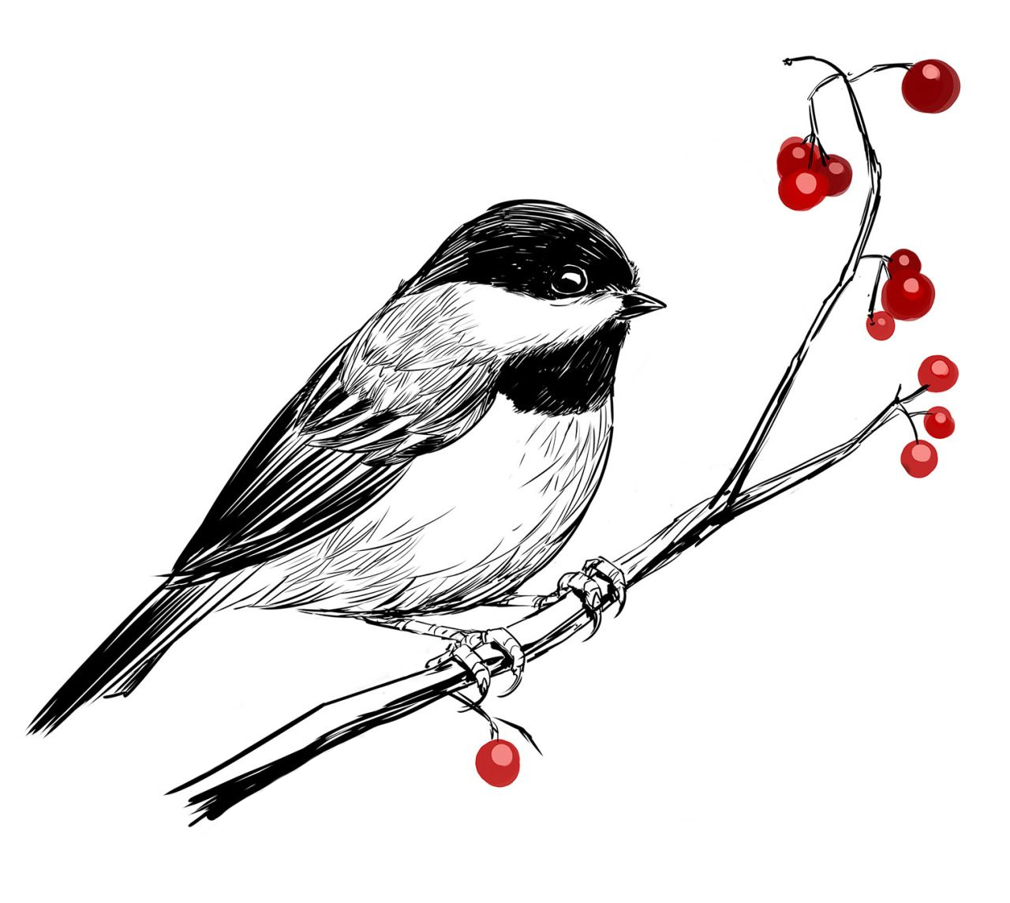
Chickadee Wait Queues: A Simple Block-until-timer-firing
Sleeping thread wants to block until the next timer interrupt
Waking thread runs every timer interrupt
//Sleeper
waiter w(this);
w.prepare(waitq);
w.block();
w.clear();
//Waker
waitq.wake_all();

Slide 22
struct waiter {
proc* p_;
wait_queue* wq_;
list_links links_;
inline waiter(proc* p);
//...other stuff...
};
Sleeping thread wants to block until the next timer interrupt
Waking thread runs every timer interrupt
//Sleeper
waiter w(this);
w.prepare(waitq);
w.block();
w.clear();
//Waker
waitq.wake_all();

Slide 23
Locks waitq
Sets p->state_ to proc::blocked; note that the associated kernel thread is still running!
Adds w to a linked list of waiters associated with waitq
Unlocks waitq
Sleeping thread wants to block until the next timer interrupt
Waking thread runs every timer interrupt
//Sleeper
waiter w(this);
w.prepare(waitq);
w.block();
w.clear();
//Waker
waitq.wake_all();

Slide 24
Calls p->yield(), which then invokes the scheduler cpustate::schedule(), where
If p->state_ == blocked due to the prior w.prepare(&waitq), then p won’t be added to cpu’s runqueue
If p->state_ == runnable because waitq.wake_all() ran between w.prepare(waitq) and w.block(), then p won’t block (i.e., p will be added to the runqueue)
When p->yield() returns, w.block() calls waiter::clear() to clean up the waiter
Sleeping thread wants to block until the next timer interrupt
Waking thread runs every timer interrupt
//Sleeper
waiter w(this);
w.prepare(waitq);
w.block();
w.clear();
//Waker
waitq.wake_all();

Slide 25
Locks waitq
Sets p->state_ to proc::runnable
Removes the waiter from the linked list, if it is currently linked
Unlocks waitq
Sleeping thread wants to block until the next timer interrupt
Waking thread runs every timer interrupt
//Sleeper
waiter w(this);
w.prepare(waitq);
w.block();
w.clear();
//Waker
waitq.wake_all();

Slide 26
void wait_queue::wake_all() {
spinlock_guard guard(lock_);
while (auto w = q_.pop_front()) {
w->wake();
}
}
Acquire runqueue lock for waiter’s cpu
If p->state_ == blocked
p->state_ = runnable
Enqueue p on runqueue
Release runqueue lock
Sleeping thread wants to block until the next timer interrupt
Waking thread runs every timer interrupt
//Sleeper
waiter w(this);
w.prepare(waitq);
w.block();
w.clear();
//Waker
waitq.wake_all();

Slide 27
waitq.wake_all() will set p->state_ to runnable, so w.block()...p->yield()...cpustate:schedule() puts p on runqueue immediately
Sleeping thread wants to block until the next timer interrupt
Waking thread runs every timer interrupt
//Sleeper
waiter w(this);
w.prepare(waitq);
w.block();
w.clear();
//Waker
waitq.wake_all();

Slide 28
Sleeper has just missed the most recent timer interrupt. So, it will block until the next one, when waitq.wake_all() will set p->state_ to runnable
Sleeping thread wants to block until the next timer interrupt
Waking thread runs every timer interrupt
//Sleeper
waiter w(this);
w.prepare(waitq);
w.block();
w.clear();
//Waker
waitq.wake_all();

Slide 29
Sleeper has awoken from w.block(), due to a previous timer firing; w.block() has called w.clear(), so the sleeper will miss the new wakeup, which is correct according to the spec.
Sleeping thread wants to block until the next timer interrupt
Waking thread runs every timer interrupt
//Sleeper
waiter w(this);
w.prepare(waitq);
w.block();
w.clear();
//Waker
waitq.wake_all();

Slide 30
Sleeper has awoken from w.block(), due to a previous timer firing; w.block() has called w.clear(), so the sleeper will miss the new wakeup, which is correct according to the spec.
Sleeping thread wants to block until the next timer interrupt
Waking thread runs every timer interrupt
//Sleeper
waiter w(this);
w.prepare(waitq);
w.block();
w.clear();
//Waker
waitq.wake_all();

Slide 31
A More Complicated Example:
The waiter does not want to unblock until f(x) == true
The waker manipulates program state to make f(x) == true
x must be protected by x_lock

Slide 32
Chickadee Wait Queues
struct waiter {
proc* p_;
wait_queue* wq_;
list_links links_;
inline waiter(proc* p);
//...other stuff...
};
//Inside a kernel thread
waiter w(this);
auto irqs = x_lock.lock();
while (1) {
w.prepare(&waitq);
if (f(x)) {
break;
}
x_lock.unlock(irqs);
w.block();
irqs = x_lock.lock();
}
w.clear();
//Compute using x
x_lock.unlock(irqs);
Notes:
[Ref: https://read.seas.harvard.edu/cs161-19/doc/wait-queues/]

Slide 33
Chickadee Wait Queues
//Inside a kernel thread
waiter w(this);
auto irqs = x_lock.lock();
while (1) {
w.prepare(&waitq);
if (f(x)) {
break;
}
x_lock.unlock(irqs);
w.block();
irqs = x_lock.lock();
}
w.clear();
//Compute using x
x_lock.unlock(irqs);
Locks waitq
Sets p->state_ to proc::blocked; note that the associated kernel thread is still running!
Adds w to a linked list of waiters associated with waitq
Unlocks waitq
Notes:
[This slide and the next three describe the high-level workings of prepare(), block(), and clear(), but students have to actually implement these functions for pset2.]

Slide 34
Chickadee Wait Queues
//Inside a kernel thread
waiter w(this);
auto irqs = x_lock.lock();
while (1) {
w.prepare(&waitq);
if (f(x)) {
break;
}
x_lock.unlock(irqs);
w.block();
irqs = x_lock.lock();
}
w.clear();
//Compute using x
x_lock.unlock(irqs);
Locks waitq
Sets p->state_ to proc::runnable
Removes the waiter from the linked list, if it is currently linked
Unlocks waitq
Notes:
[It’s very important that interrupts be disabled throughout this whole procedure, or an ill-timed timer interrupt could cause the kernel task to block forever.]

Slide 35
Chickadee Wait Queues
Calls p->yield(), which then invokes the scheduler cpustate::schedule(), where
If p->state_ == blocked due to the prior w.prepare(&waitq), then p won’t be added to cpu’s runqueue
If p->state_ == runnable because waitq.wake_all() ran between x_lock.unlock(irqs) and w.block(), then p won’t block (i.e., p will be added to the runqueue)
When p->yield() returns, w.block() calls waiter::clear() to clean up the waiter
//Inside a kernel thread
waiter w(this);
auto irqs = x_lock.lock();
while (1) {
w.prepare(&waitq);
if (f(x)) {
break;
}
x_lock.unlock(irqs);
w.block();
irqs = x_lock.lock();
}
w.clear();
//Compute using x
x_lock.unlock(irqs);

Slide 36
Chickadee Wait Queues
//In the wakeup thread...
void f() {
spinlock_guard guard(x_lock);
//Stuff making f(x) true, then...
wq.wake_all();
}
void wait_queue::wake_all() {
spinlock_guard guard(lock_);
while (auto w = q_.pop_front()) {
w->wake();
}
}
void waiter::wake() {
//Your code here
}
Acquire runqueue lock for waiter’s cpu
If p->state_ == blocked
p->state_ = runnable
Enqueue p on runqueue
Release runqueue lock

Slide 37
//Note that enqueue() doesn’t add p to the
//runqueue if p is already running on the
//cpu or p is already present in a runqueue!
void cpustate::enqueue(proc* p) {
if (current_ != p && !p->runq_links_.is_linked()) {
runq_.push_back(p);
}
}

Slide 38
Wakeup thread makes f(x) true, so the sleeper thread will never actually try to block!
//The sleeper thread
waiter w(this);
auto irqs = x_lock.lock();
while (1) {
w.prepare(&waitq);
if (f(x)) {
break;
}
x_lock.unlock(irqs);
w.block();
irqs = x_lock.lock();
}
w.clear();
//Compute using x
x_lock.unlock(irqs);
//The wakeup thread
void f() {
spinlock_guard guard(x_lock);
//Stuff making f(x) true, then...
wq.wake_all();
}
void wait_queue::wake_all() {
spinlock_guard guard(lock_);
while (auto w = q_.pop_front()) {
w->wake();
}
}
void waiter::wake() {
//Your code here
}

Slide 39
Wakeup thread makes f(x) true, sets p->state_ = runnable, so
w.block()…p->yield()…cpustate:schedule() puts p on runqueue immediately
//The sleeper thread
waiter w(this);
auto irqs = x_lock.lock();
while (1) {
w.prepare(&waitq);
if (f(x)) {
break;
}
x_lock.unlock(irqs);
w.block();
irqs = x_lock.lock();
}
w.clear();
//Compute using x
x_lock.unlock(irqs);
//The wakeup thread
void f() {
spinlock_guard guard(x_lock);
//Stuff making f(x) true, then...
wq.wake_all();
}
void wait_queue::wake_all() {
spinlock_guard guard(lock_);
while (auto w = q_.pop_front()) {
w->wake();
}
}
void waiter::wake() {
//Your code here
}
Acquire runqueue lock for waiter’s cpu
If p->state_ == blocked
p->state_ = runnable
Enqueue p on runqueue
Release runqueue lock
Does nothing because p is already running!
Notes:
Remember that, at this point in the sleeper thread, p->state_ is blocked, because calling the prepare() function set the state_ to blocked. So, waiter::wake() will try to enqueue the awoken thread on the runqueue, but this will fail, because the awoken thread is already awoken and running on a cpu! Later, when the “awoken” thread calls w.block(), the thread will actually get added to the cpu’s runqueue.

Slide 40
Sleeper had already been awoken, so the sleeper will grab the lock and see that f(x) == true
//The sleeper thread
waiter w(this);
auto irqs = x_lock.lock();
while (1) {
w.prepare(&waitq);
if (f(x)) {
break;
}
x_lock.unlock(irqs);
w.block();
irqs = x_lock.lock();
}
w.clear();
//Compute using x
x_lock.unlock(irqs);
//The wakeup thread
void f() {
spinlock_guard guard(x_lock);
//Stuff making f(x) true, then...
wq.wake_all();
}
void wait_queue::wake_all() {
spinlock_guard guard(lock_);
while (auto w = q_.pop_front()) {
w->wake();
}
}
void waiter::wake() {
//Your code here
}
Notes:
Note that, if there are multiple sleepers, then the first one to grab x_lock might manipulate x in a way that makes f(x) false for the other awoken threads. For example, if x represents a single item to be consumed by a single blocker, then all but one of the awoken threads will discover that f(x) is false.

Slide 41
Wakeup thread has made f(x) true, which the sleeper will discover if the sleeper tries to enter the wait queue again
//The sleeper thread
waiter w(this);
auto irqs = x_lock.lock();
while (1) {
w.prepare(&waitq);
if (f(x)) {
break;
}
x_lock.unlock(irqs);
w.block();
irqs = x_lock.lock();
}
w.clear();
//Compute using x
x_lock.unlock(irqs);
//The wakeup thread
void f() {
spinlock_guard guard(x_lock);
//Stuff making f(x) true, then...
wq.wake_all();
}
void wait_queue::wake_all() {
spinlock_guard guard(lock_);
while (auto w = q_.pop_front()) {
w->wake();
}
}
void waiter::wake() {
//Your code here
}

